Slide 1
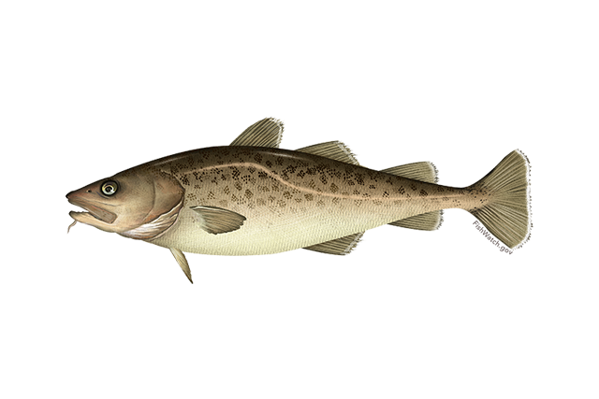
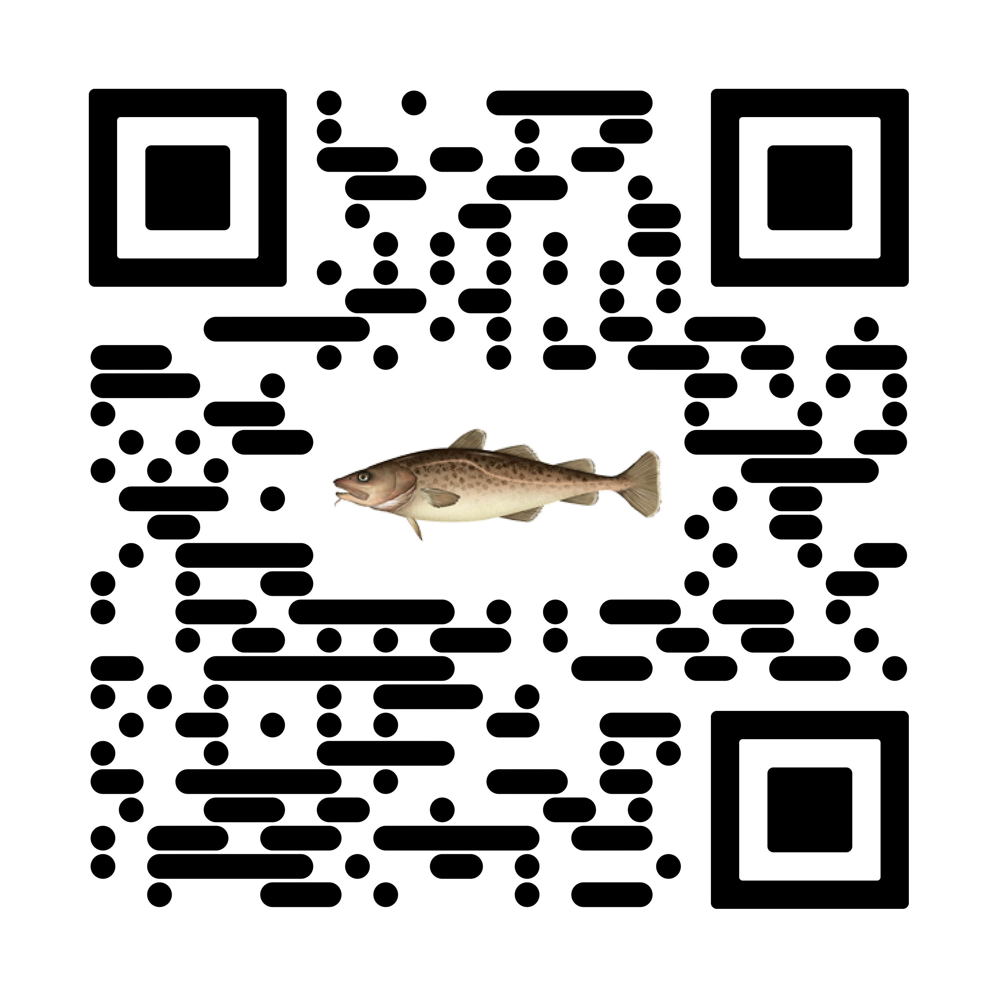


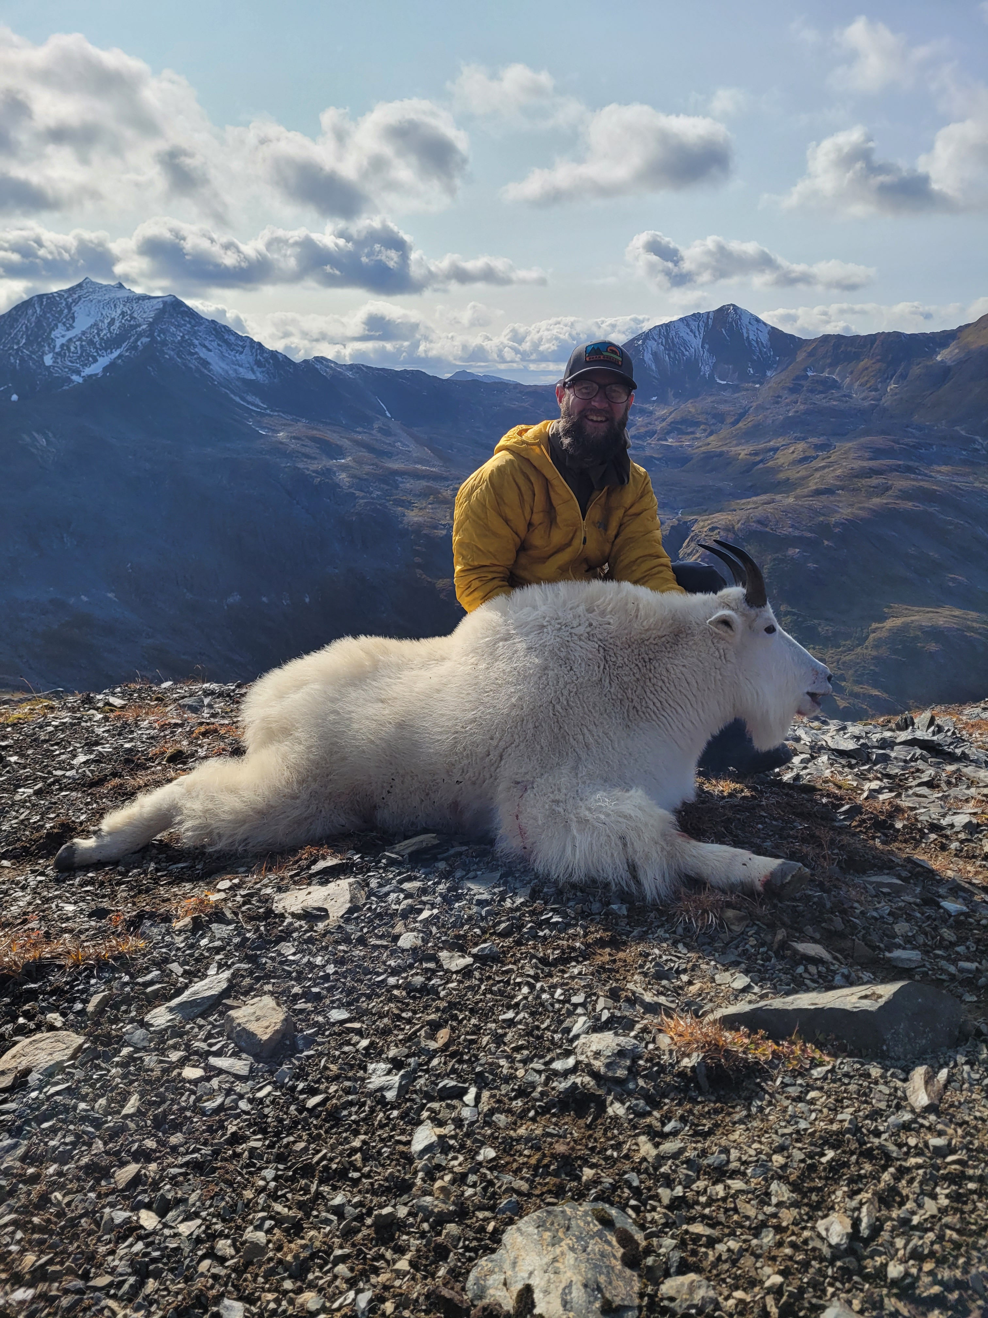

Goa pacific cod
Pete hulson, steve barbeaux, bridget ferriss, katy echave, Julie Nielsen, s. kalei shotwell, ben laurel, and Ingrid spies
December 2023, Presentation to the NPFMC SSC

Slide 2

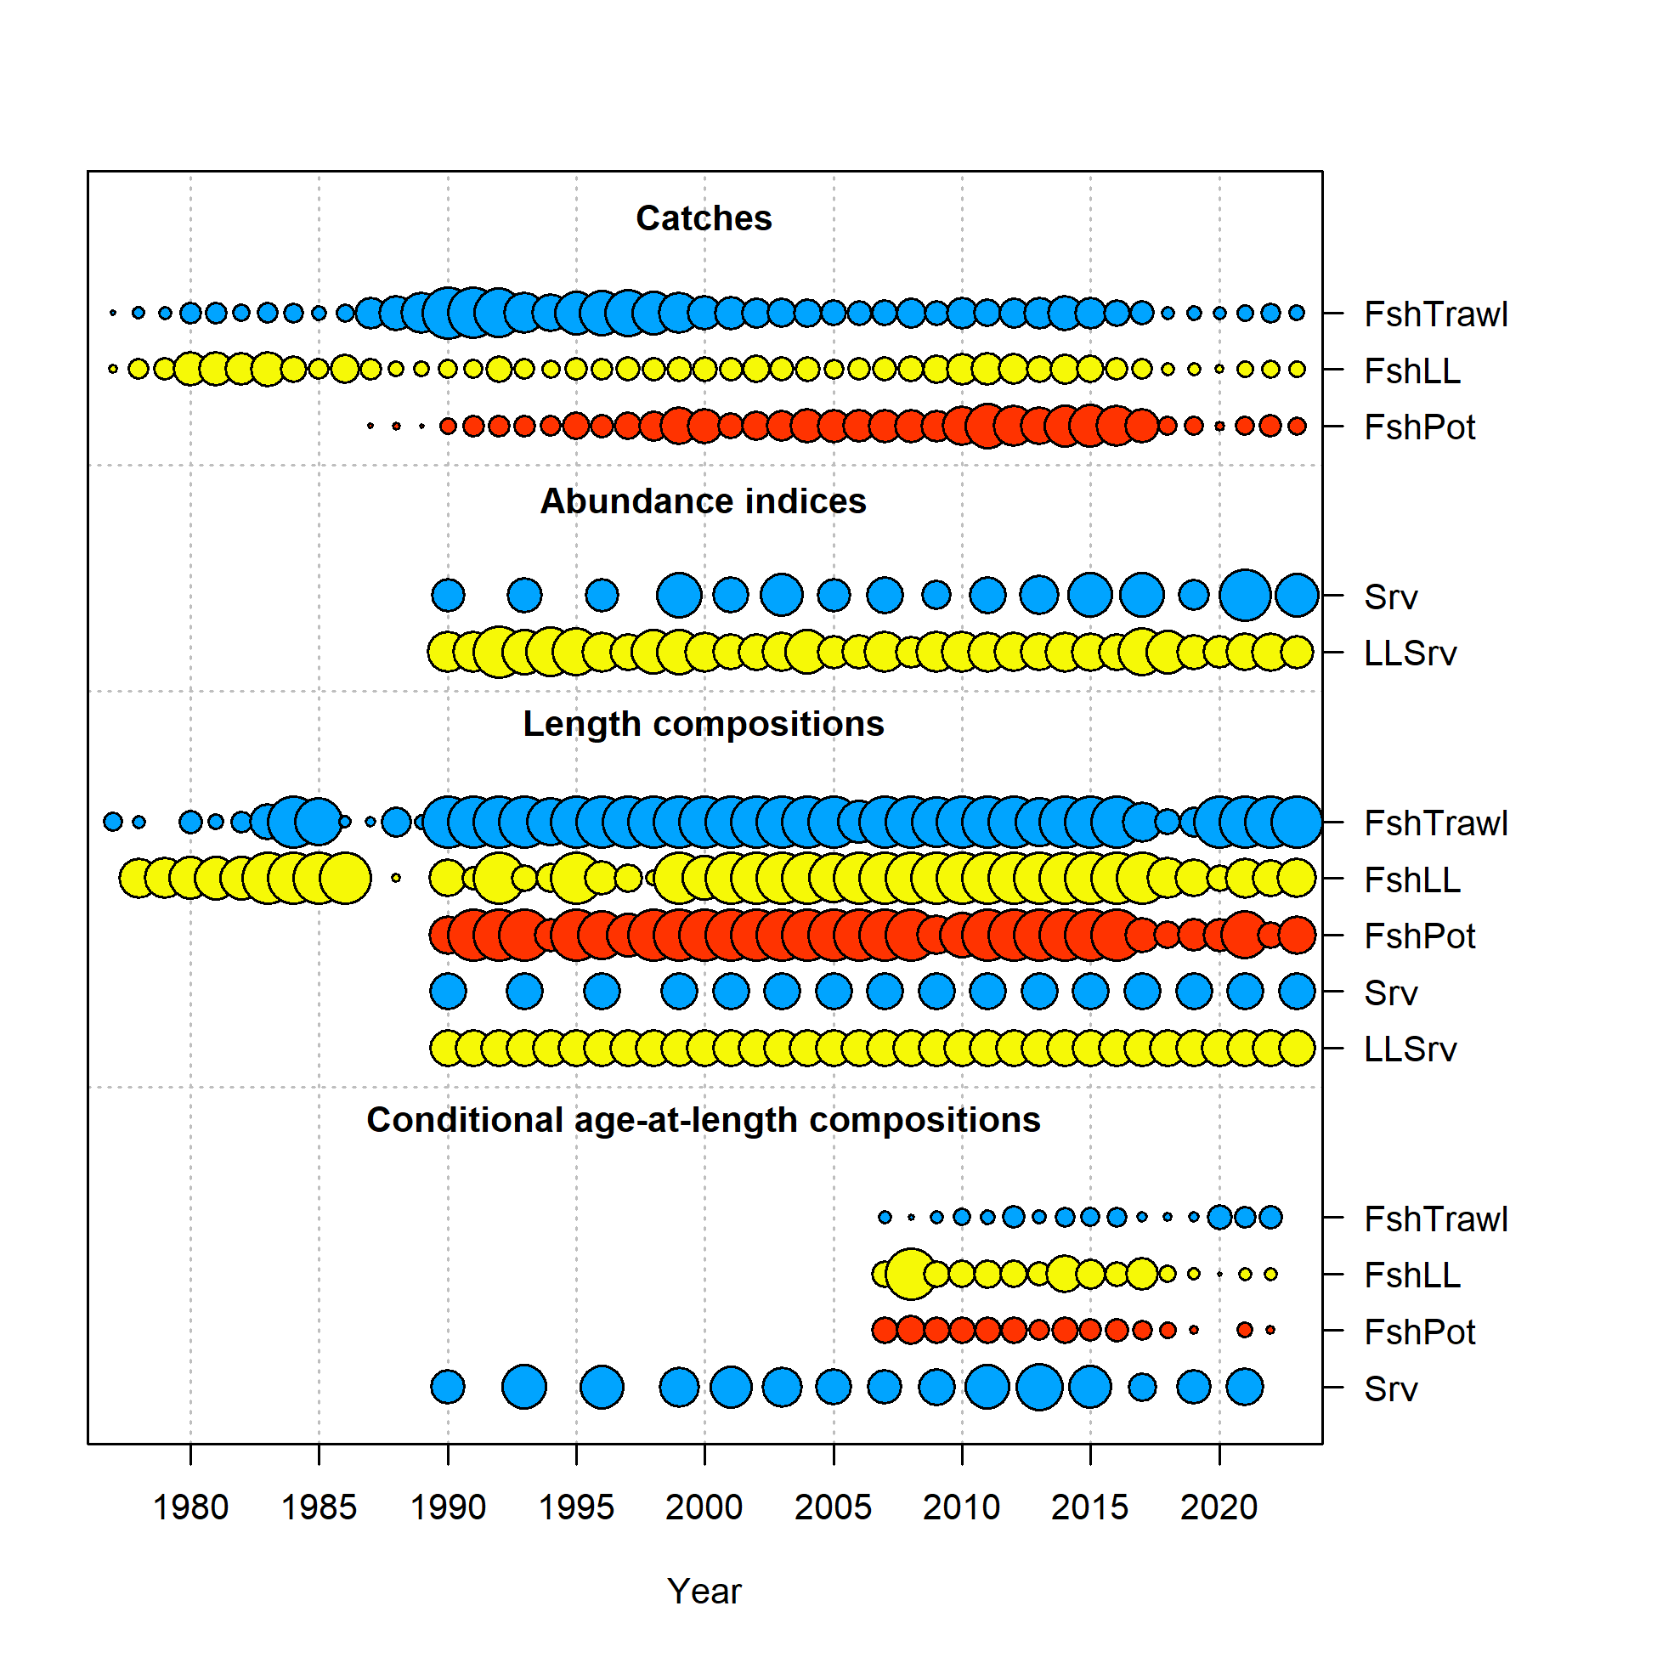
Data overview
Data | Years
Federal and state fishery catch, by gear type | 2022, 2023
Federal and state fishery length composition, by gear type | 2022, 2023
Federal fishery conditional age-at-length | 2022
GOA NMFS bottom trawl survey abundance and length composition | 2023
AFSC Sablefish Longline survey Pacific cod RPNs and length composition | 2023
CFSR bottom temperature indices | 2023

Slide 3
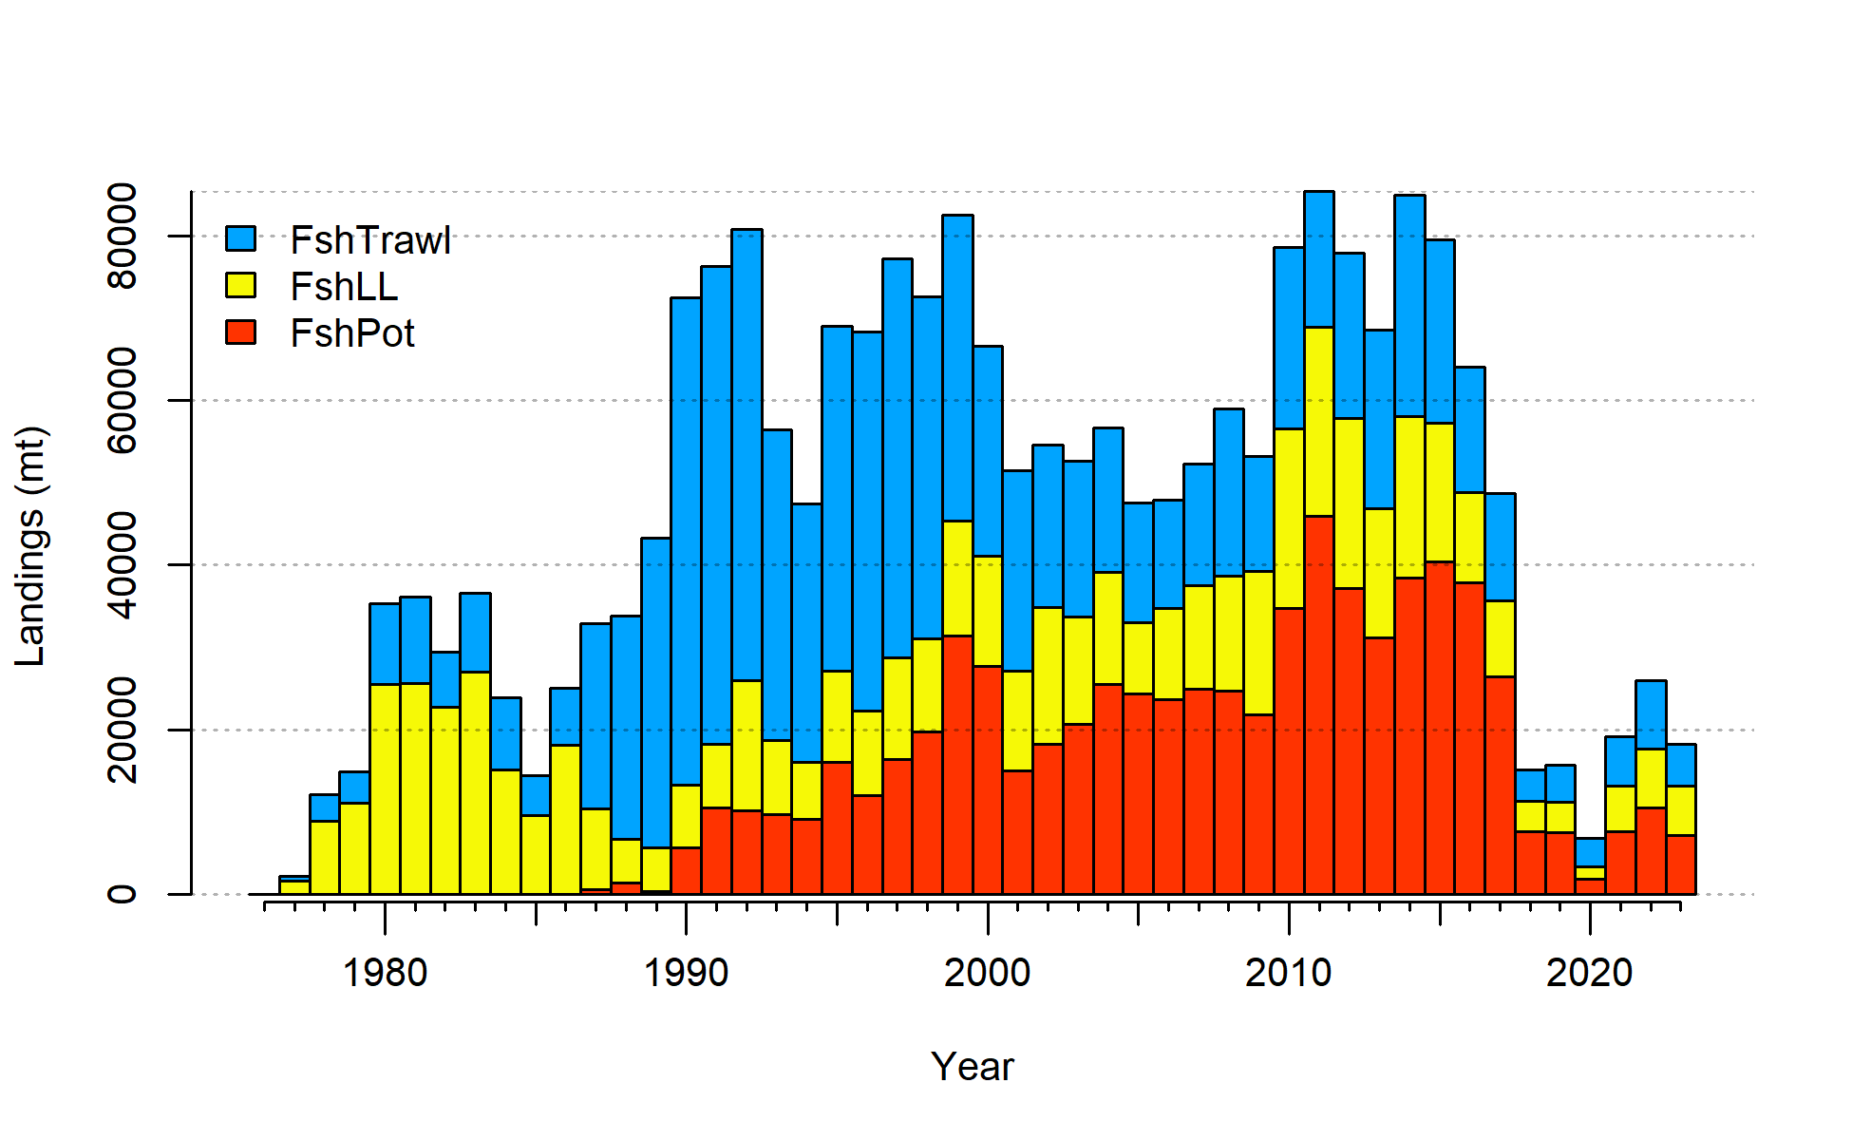
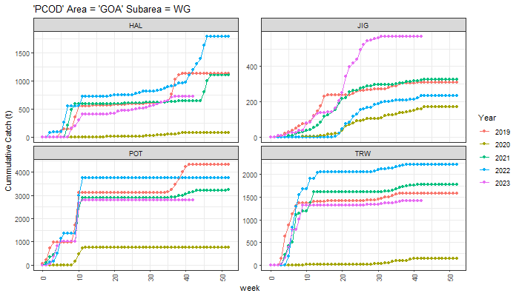
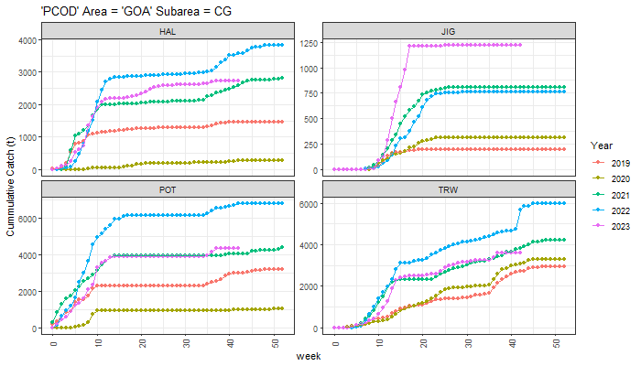
Data - Catch
Decreased since 2022
Pot majority > LL > Trawl
Large jig increase compared to previous years, others similar to what was seen in 2021

Slide 4
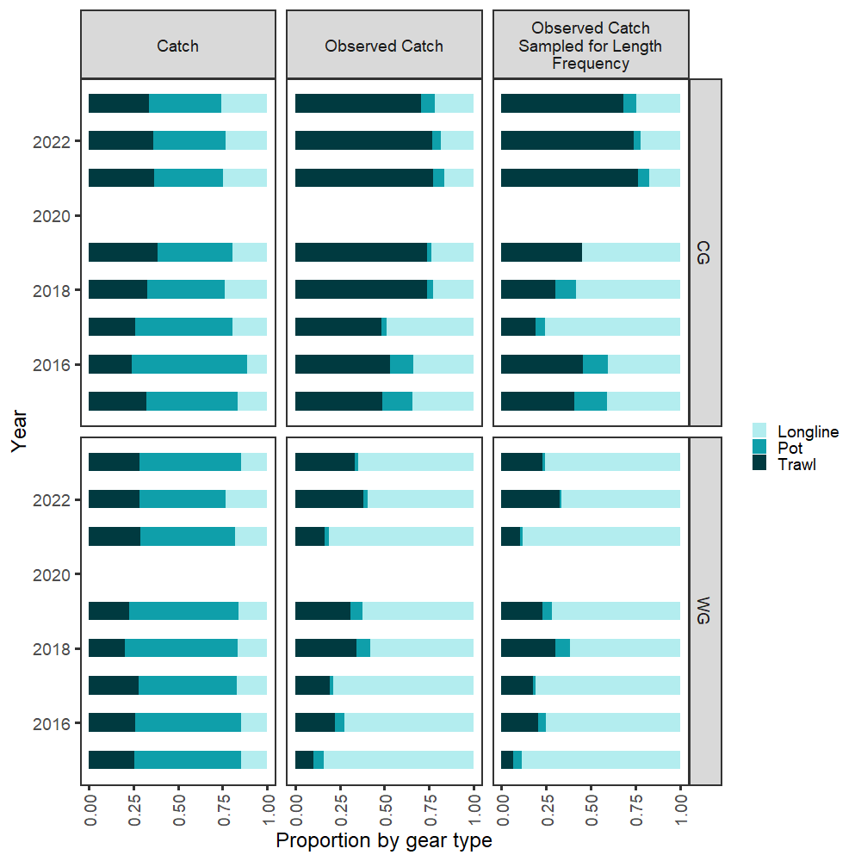
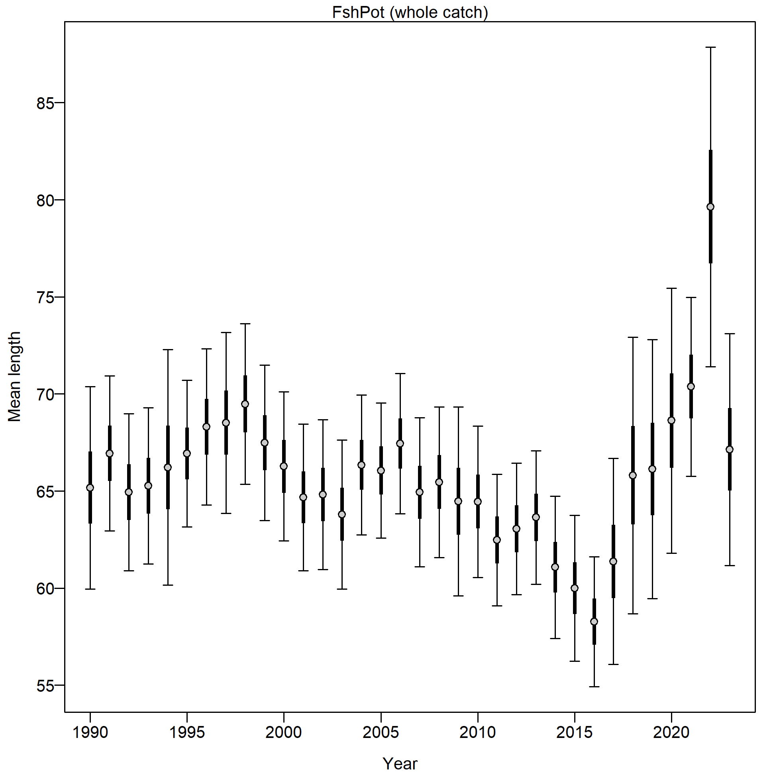
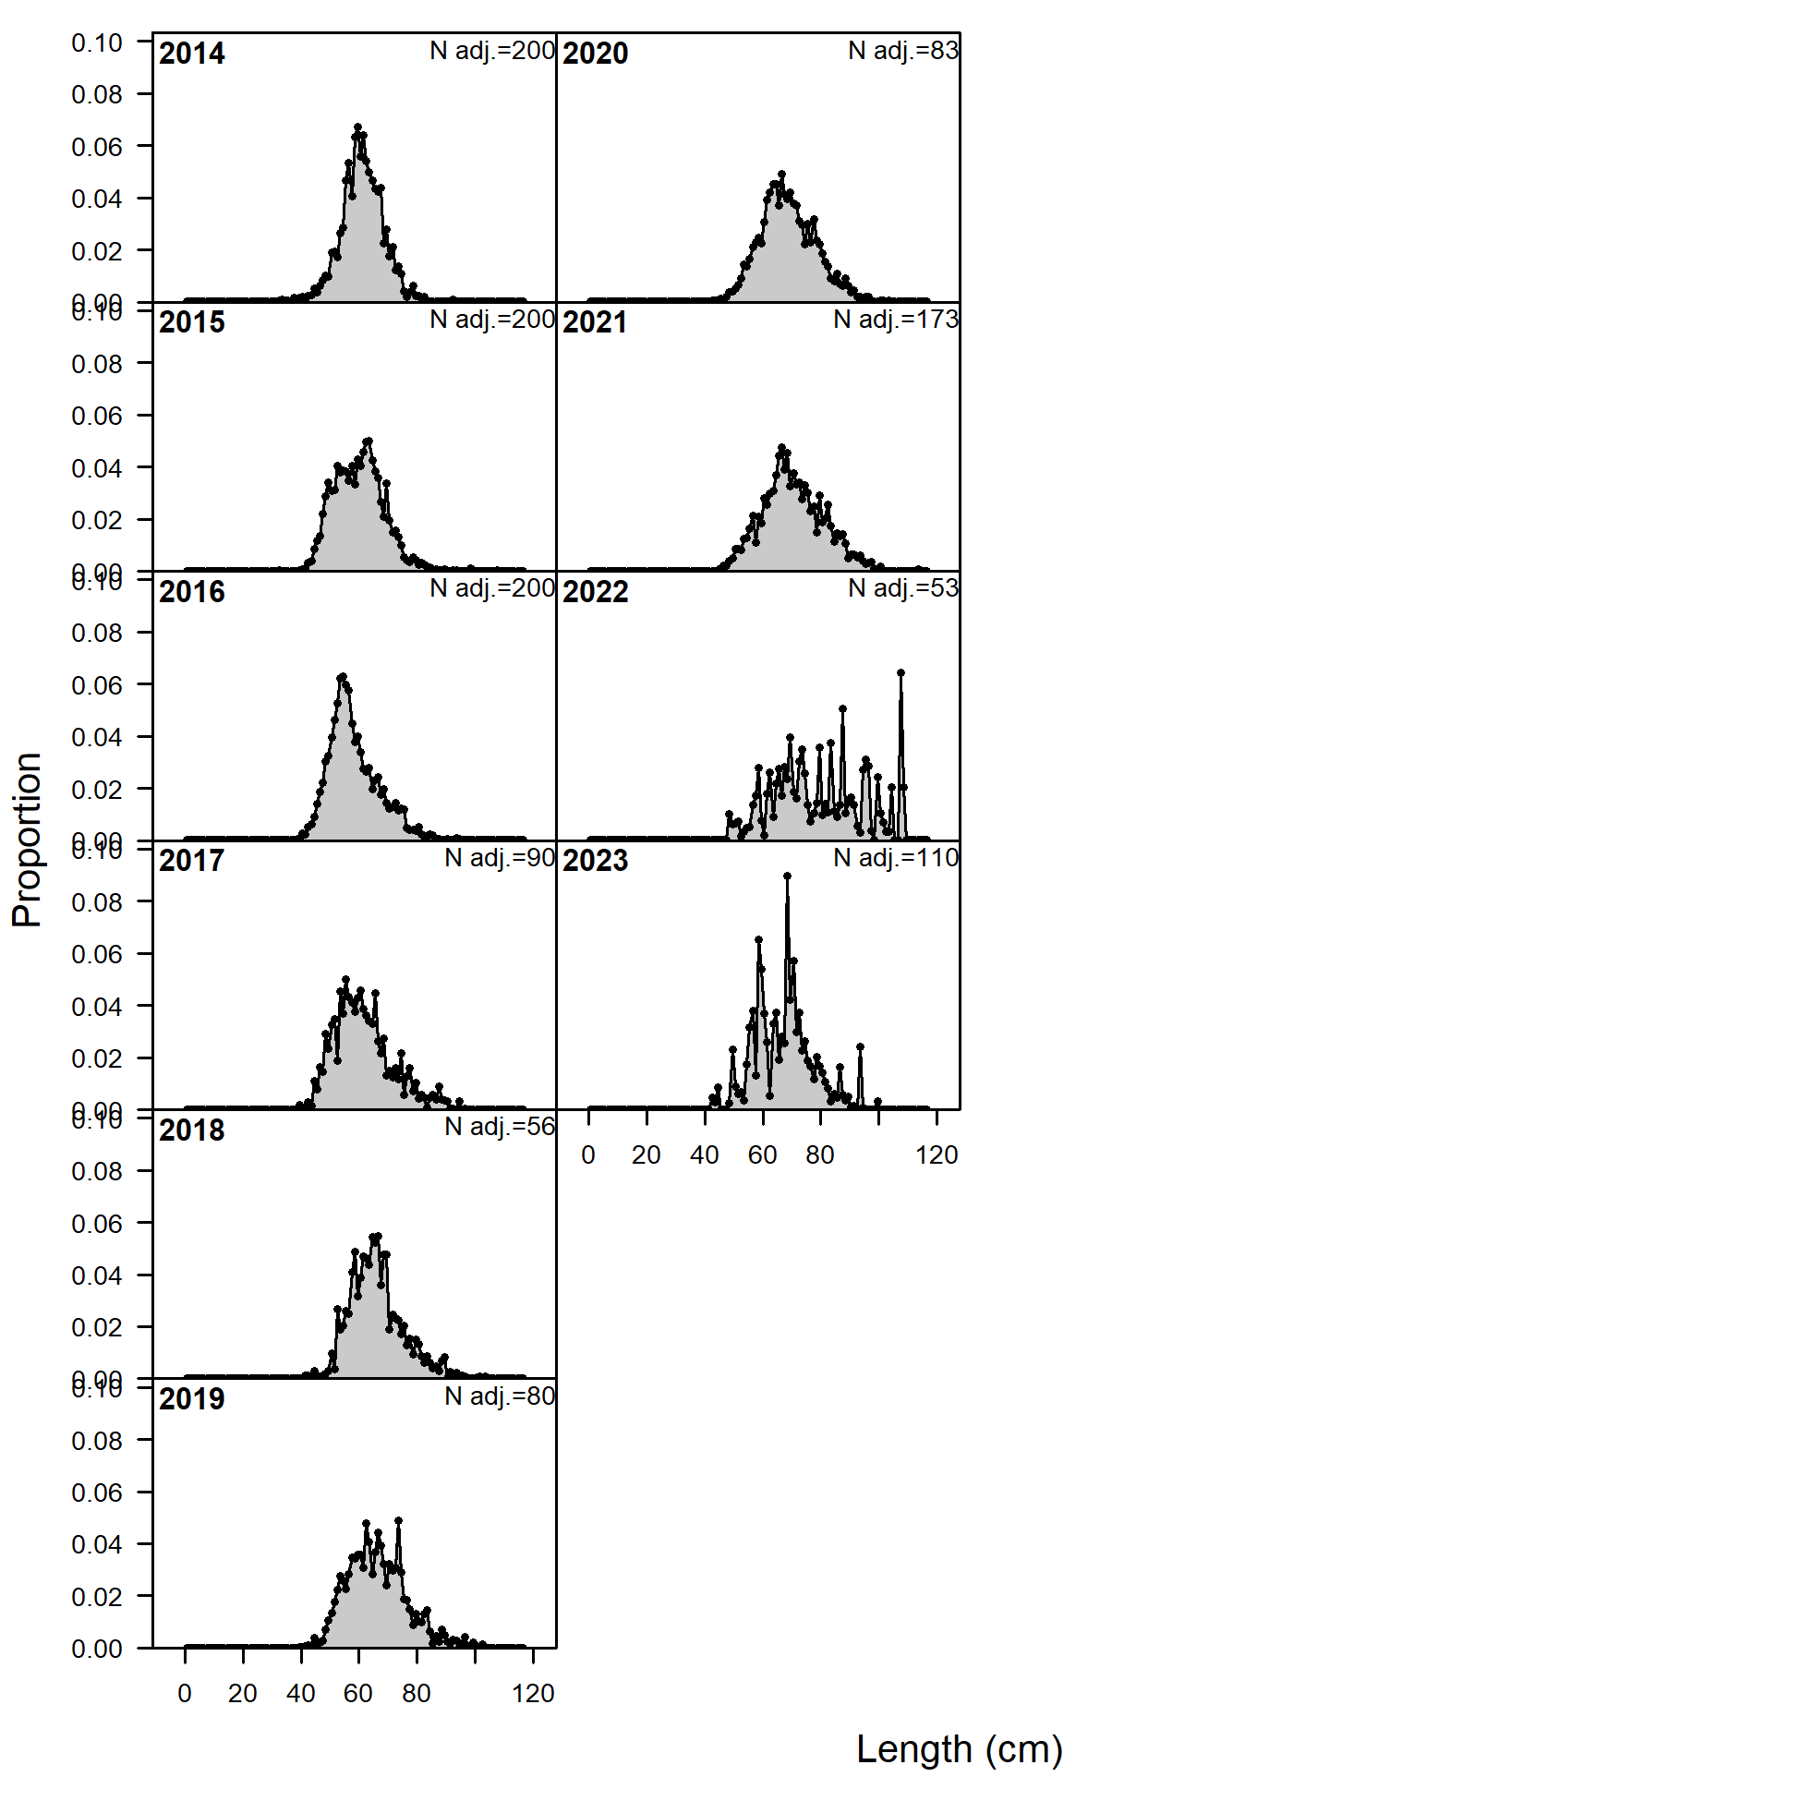
Data – pot fleet sampling
Pot fleet underrepresented in both observed catch and length frequency

Slide 5
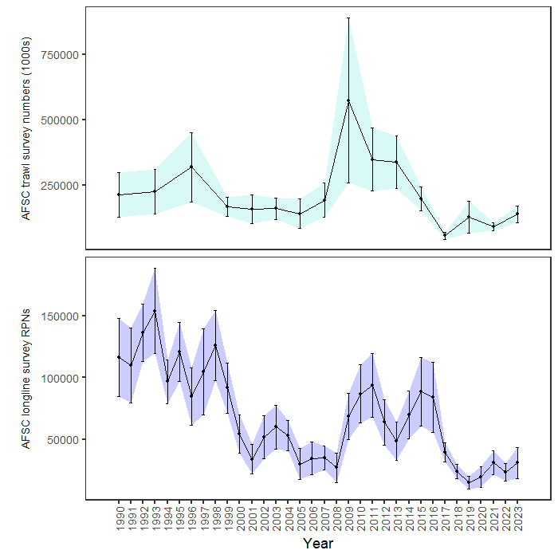
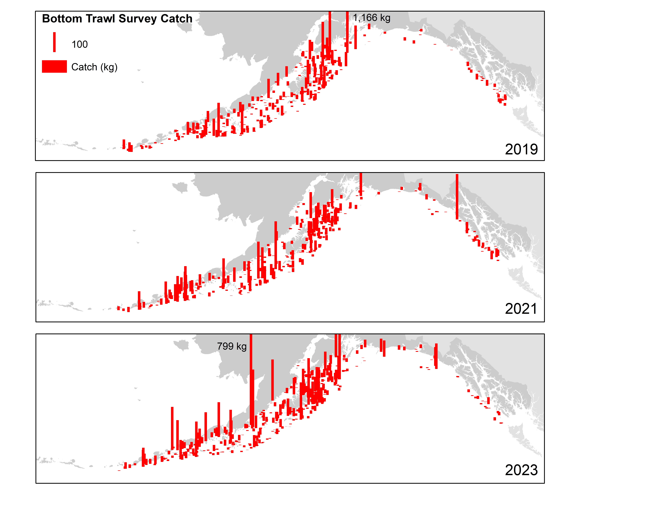
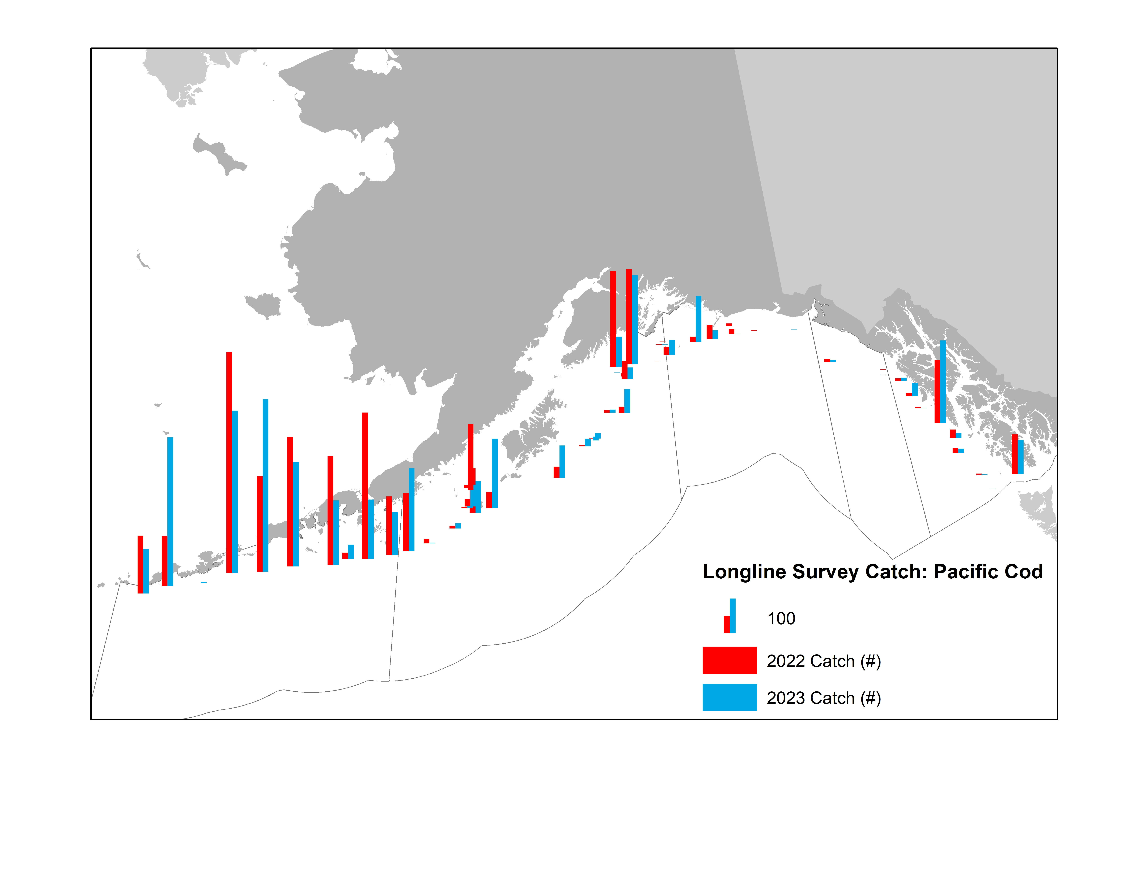
indices – fitted
+53%
+32%

Slide 6
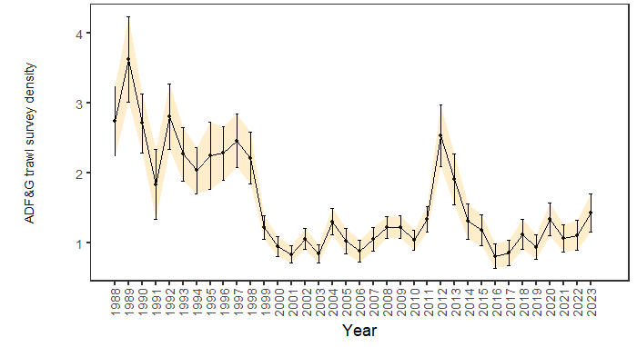

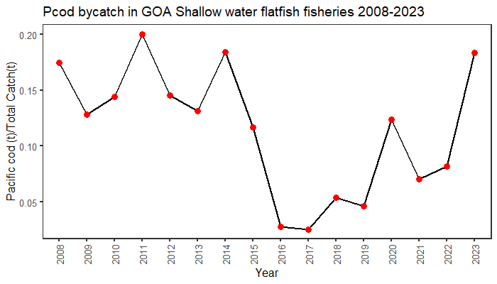
indices – monitored

Slide 7

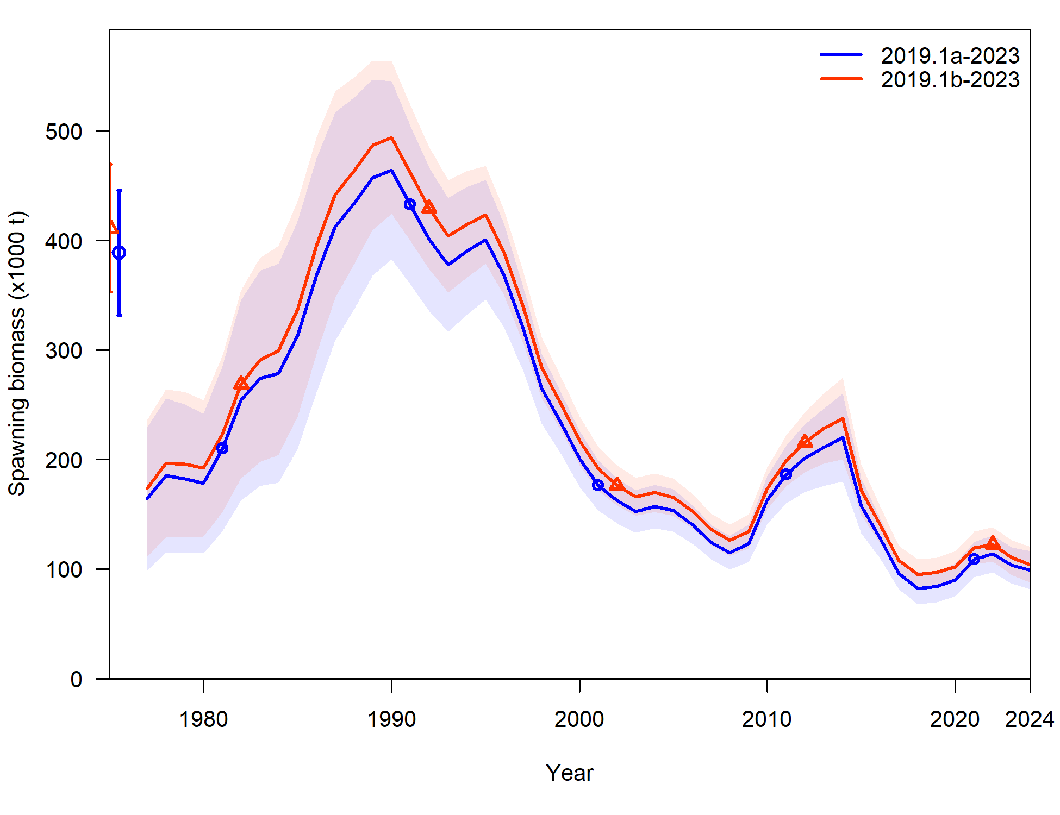
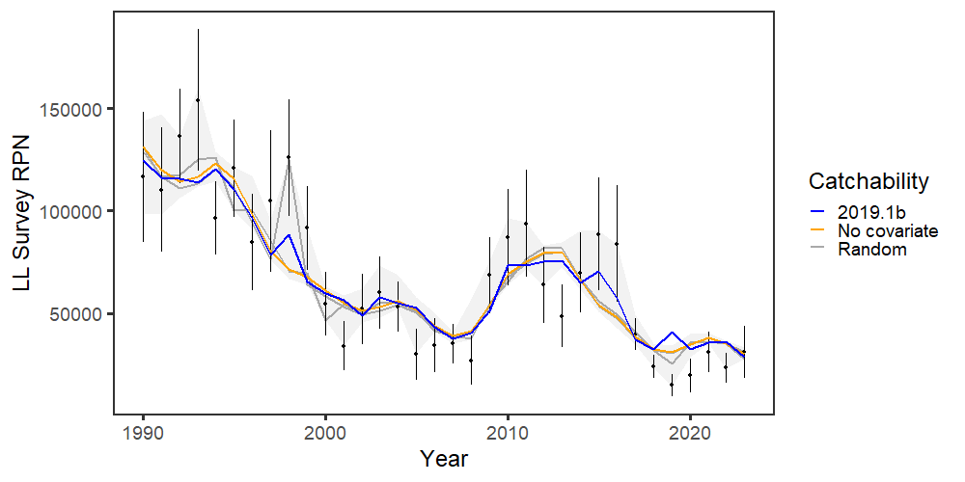
2023 assessment overview
Weighting of conditional age-at-length from 1 (19.1a) to 0.001 (19.1b) – small change in model results
Tested LL survey q environmental link
Responses to PT and SSC included in SAFE and PT presentation

Slide 8
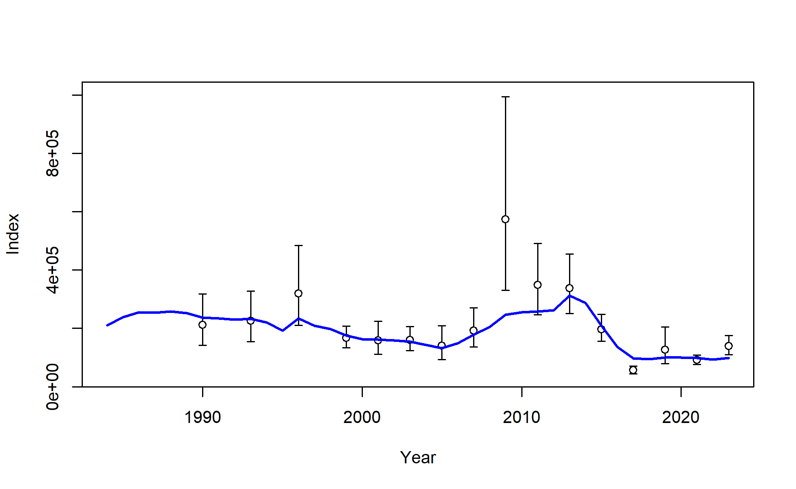
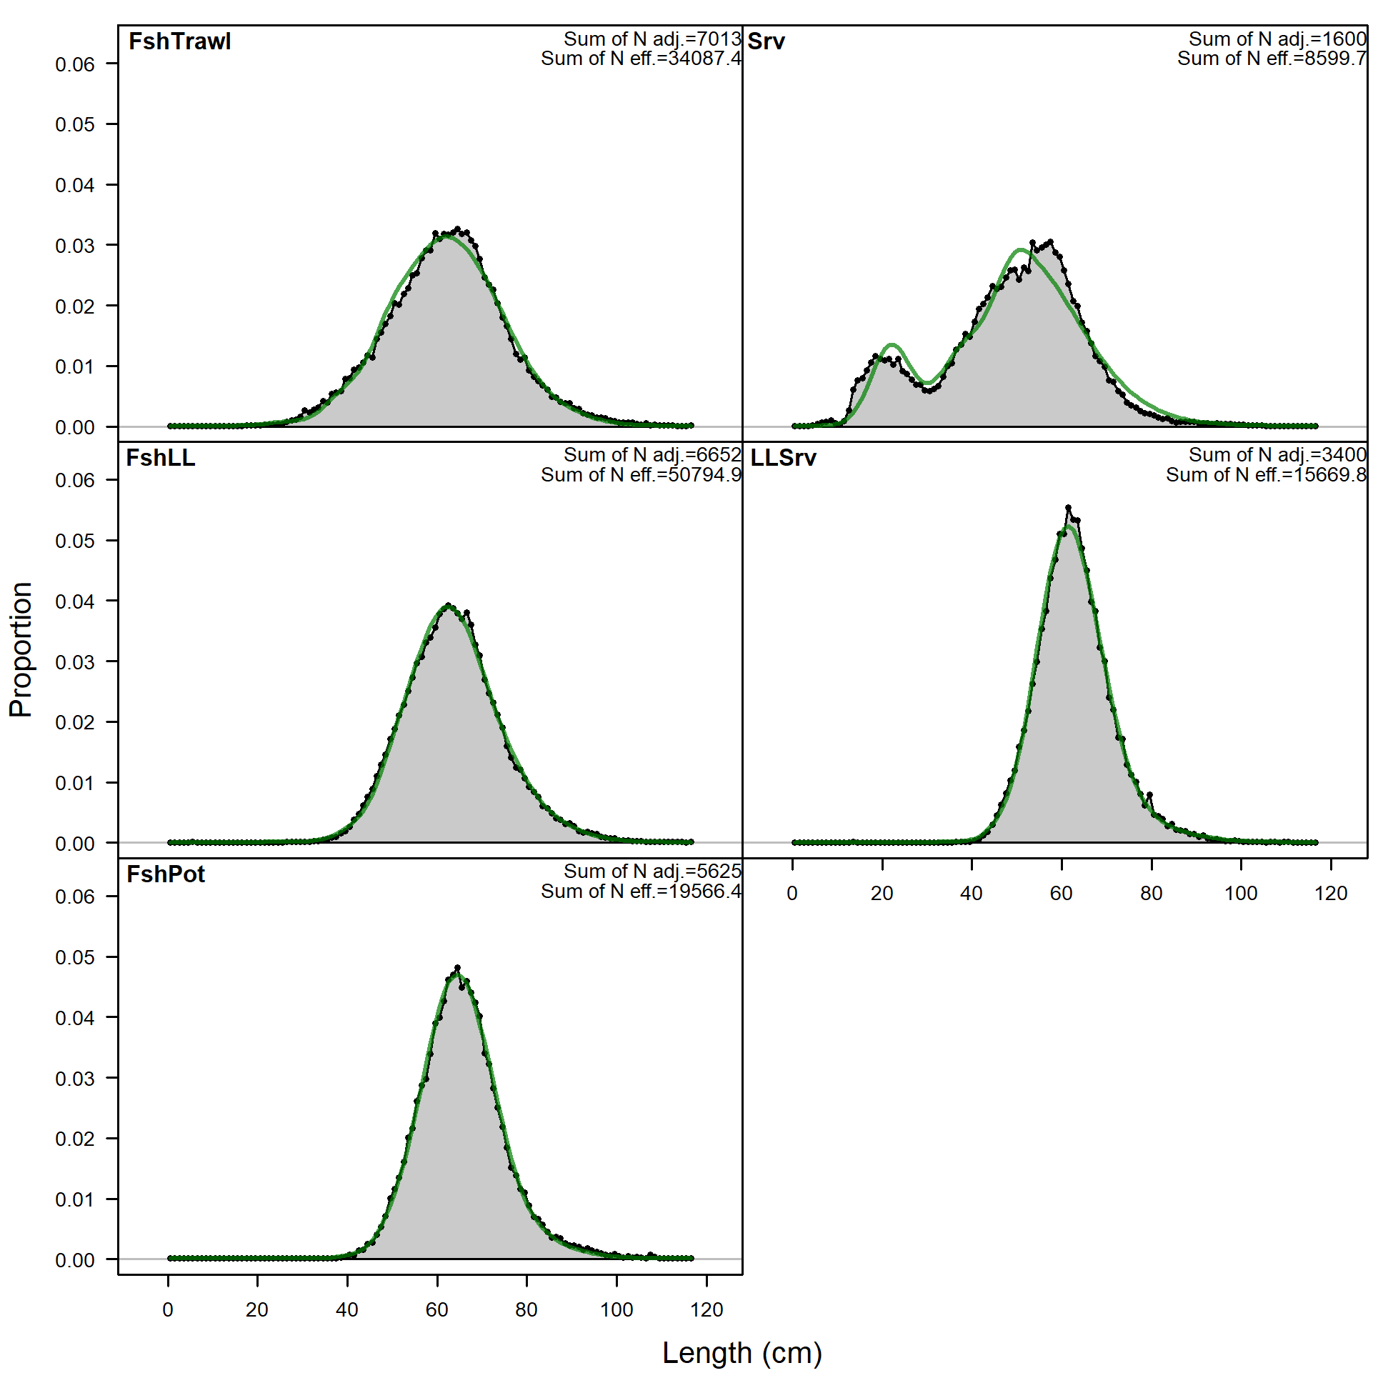
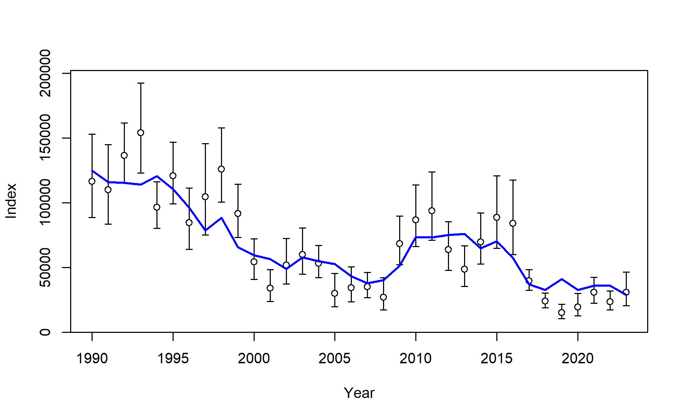
Results: data fits
AFSC bottom trawl survey numbers
AFSC longline survey RPNs

Slide 9
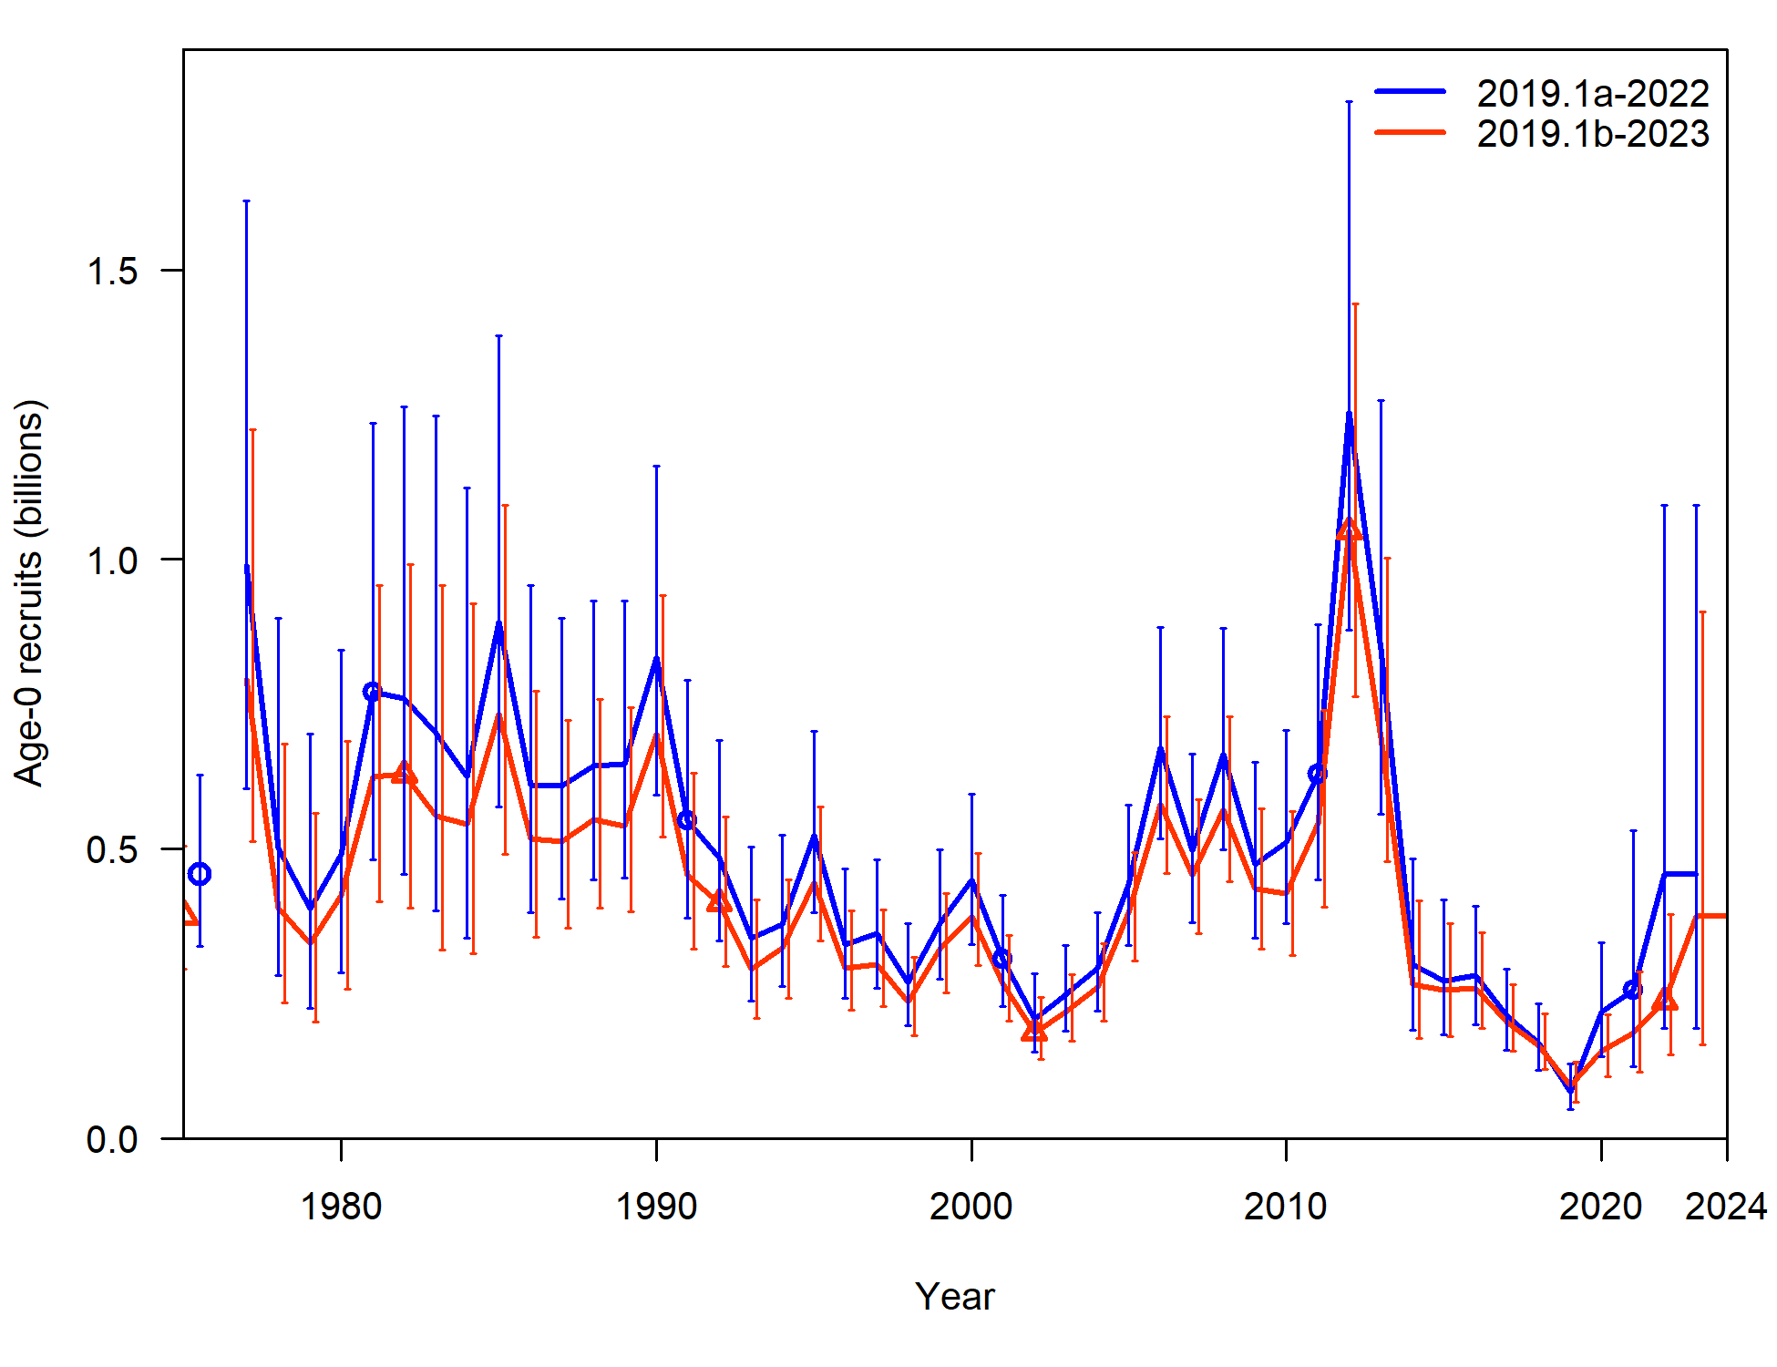
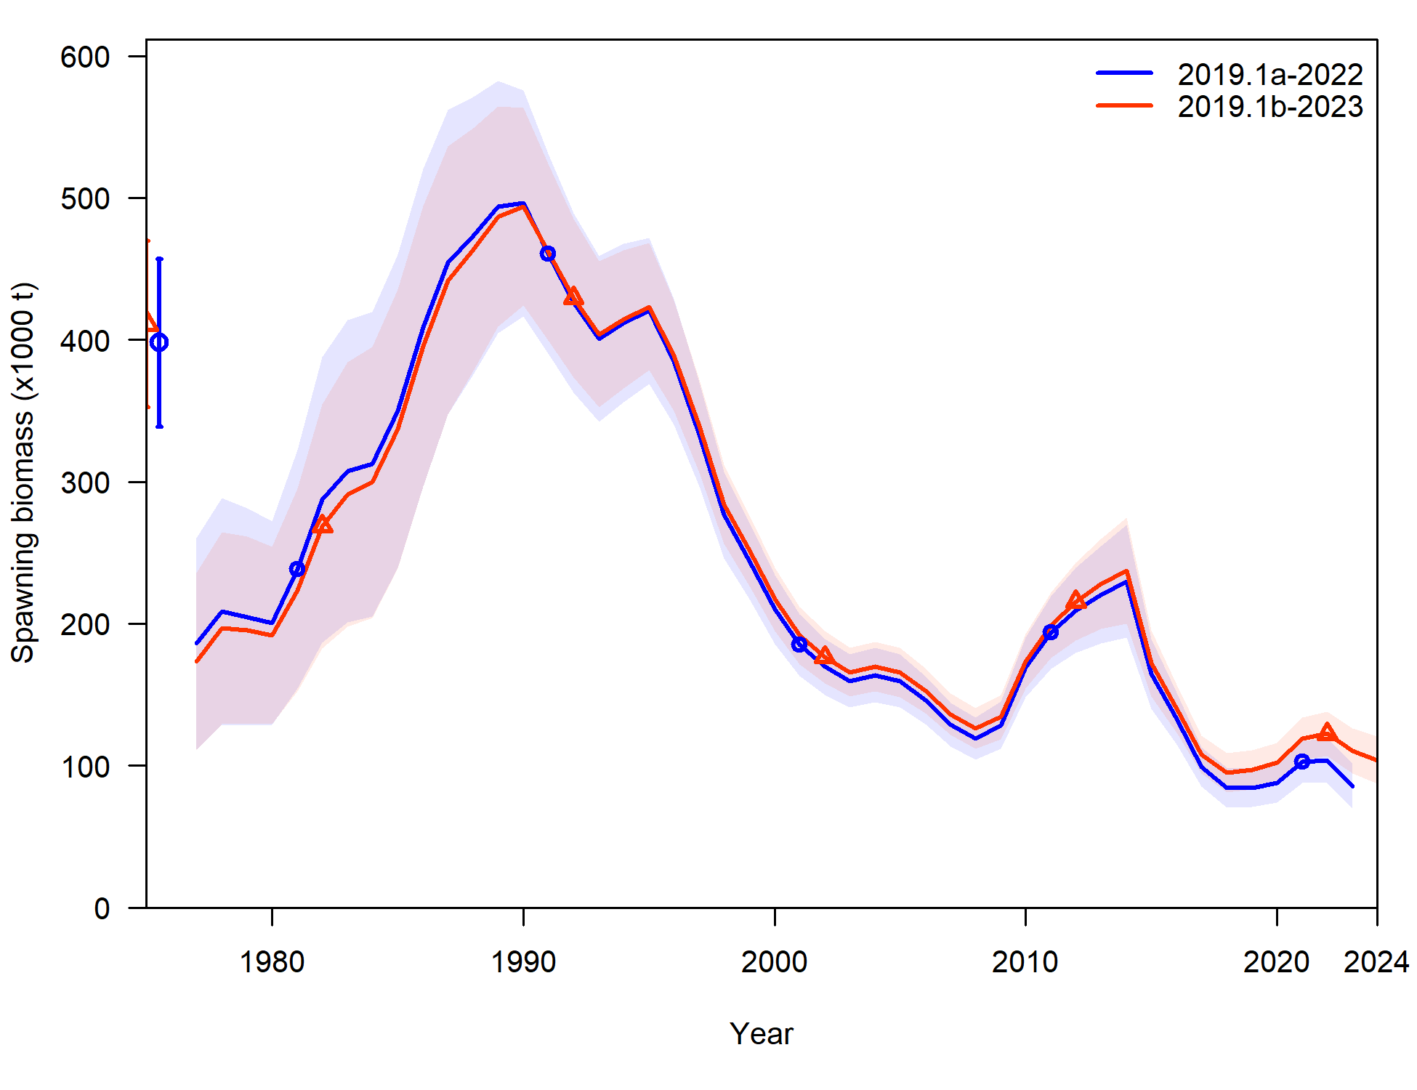
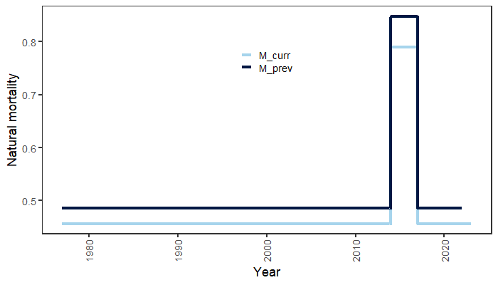
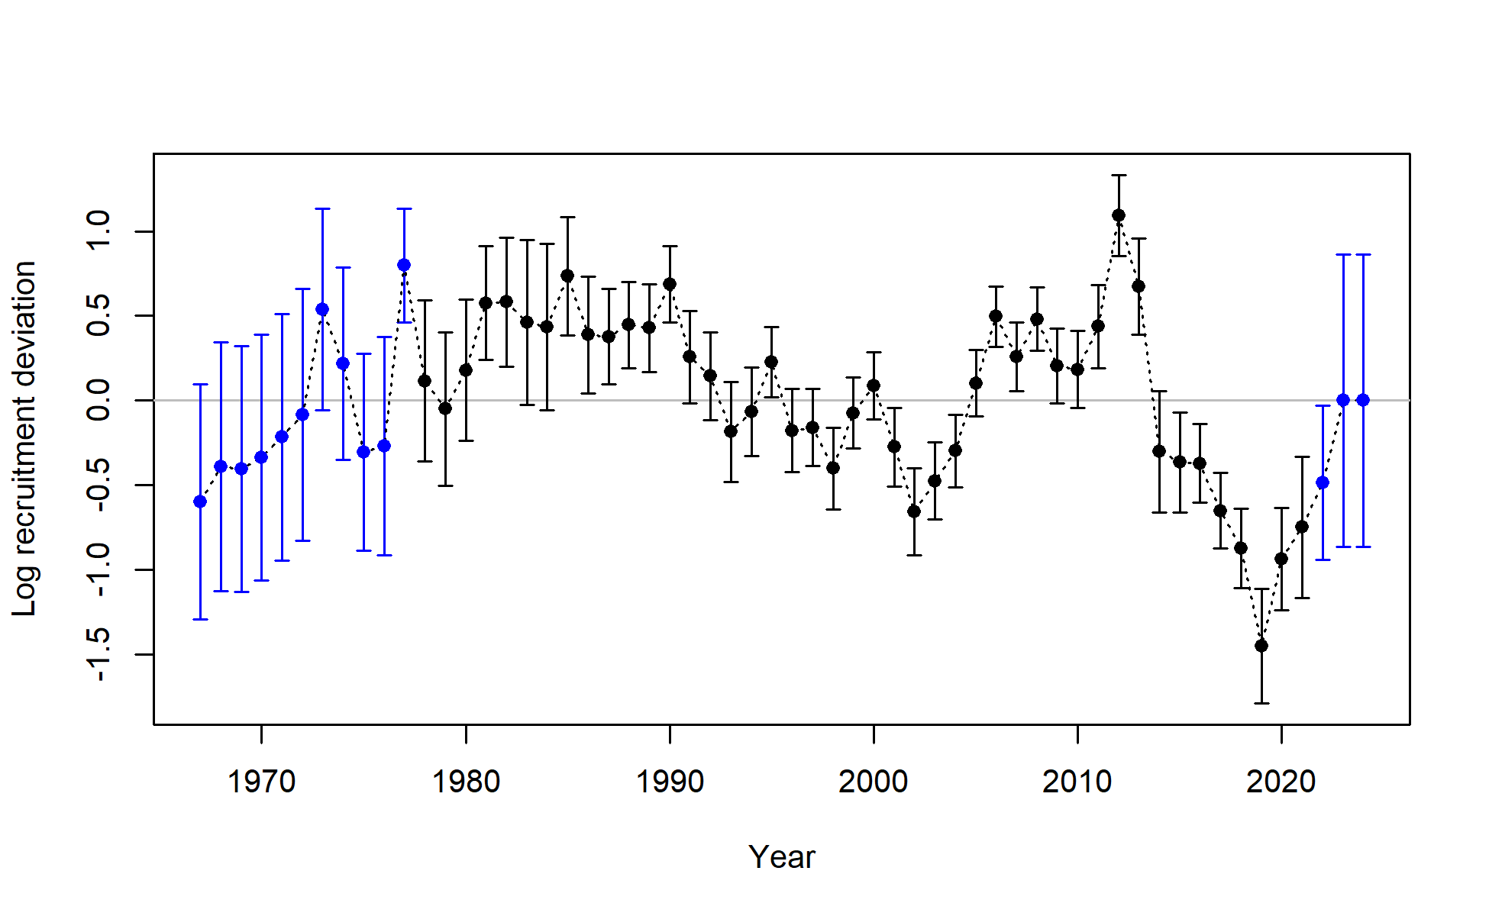
Results: time series

Slide 10
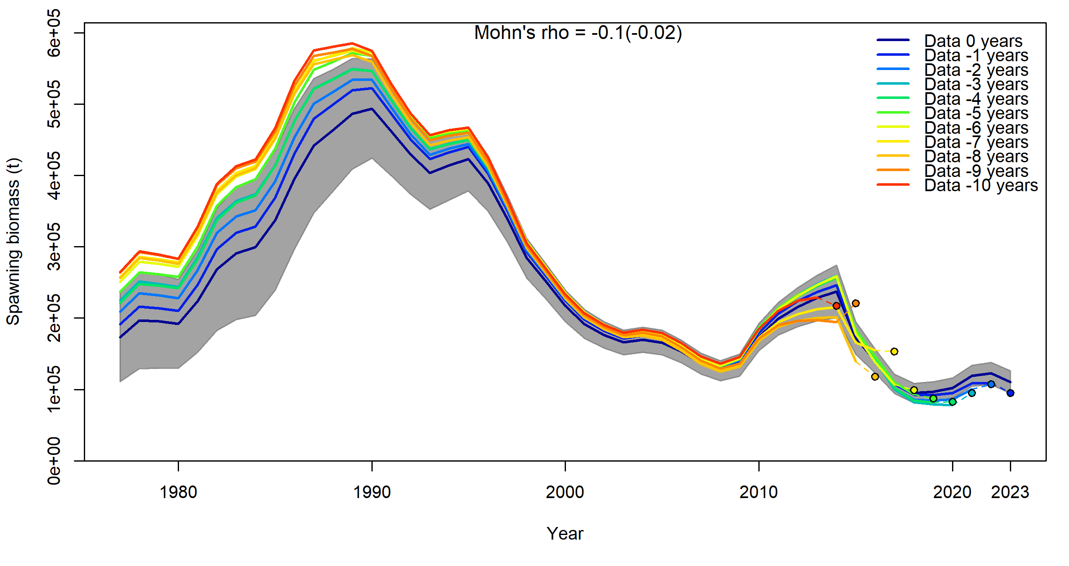
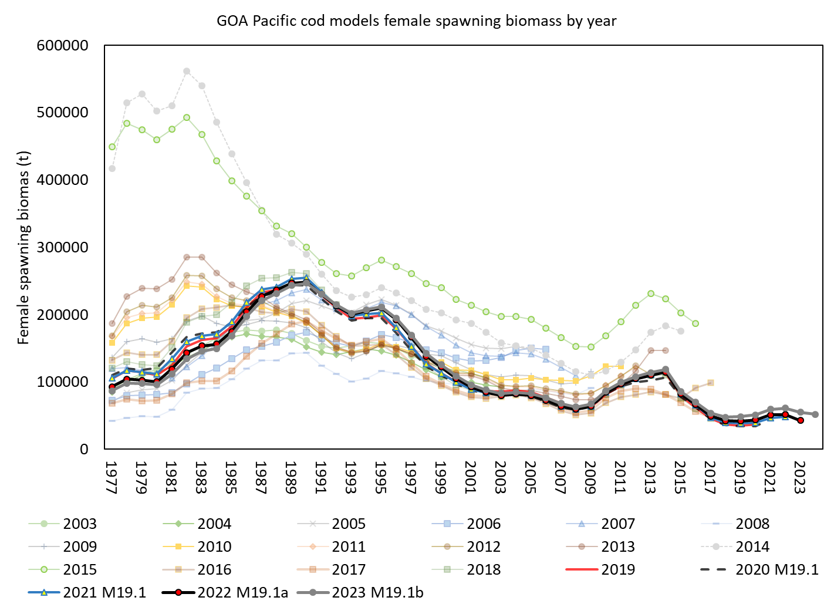
Results: retrospectives
Low recent SSB retrospective pattern in both model and data (but increased from 2022)

Slide 11

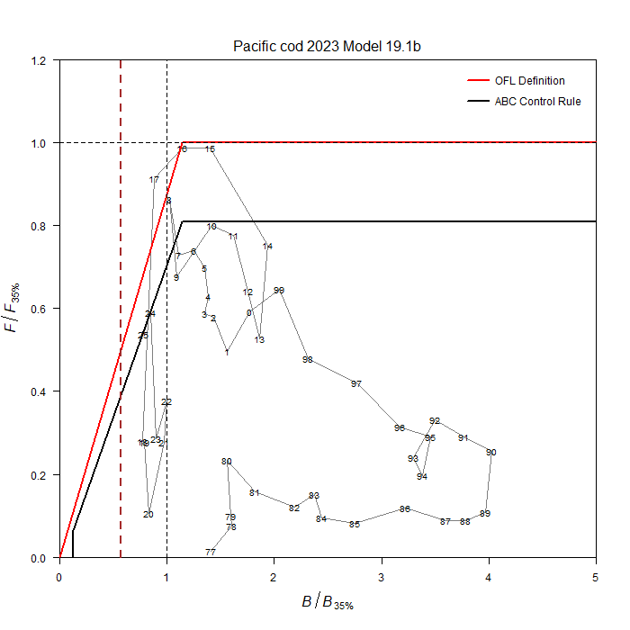
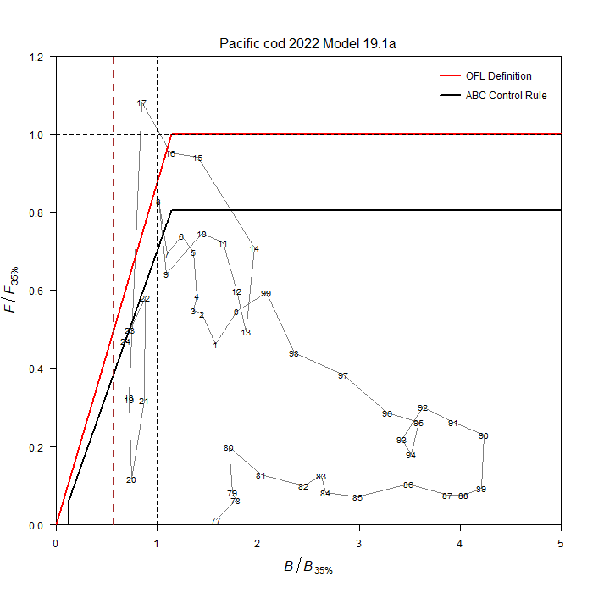
Stock status
Tier 3b: on the ramp
Moving down the ramp from 24 to 25 (but up the ramp from 2022 assessment)
Estimated to be above B_{20%} (dashed red line), 2024 = B_{29.6%}
Projected to decrease to B_{27%} in 2025

Slide 12
Risk table
Assessment considerations:
Fits to data reasonable – keep eye on LL survey fit
Below average recruitment estimated in last 7 years, and has undesirable retrospective pattern (balanced by decreasing M estimates) – projections sensitive to these results, but not in the short term
Negative SSB retrospective pattern – but that’s not bad, and not large
There are sources of uncertainty in this assessment, but nothing that is outside the norm for any of our assessments
Description of level 2: “Major problems with the stock assessment; very poor fits to data; high level of uncertainty; strong retrospective bias.” – not the case here
Lower Assessment considerations from Level 2 to Level 1

Slide 13
Risk table
Pop dy considerations:
Low levels of biomass persists – this continues to be a major concern, primarily because of how close to biomass reference limits we are
As estimated by the model, recruitment has been below average since 2014
We’ve learned population is sensitive to environmental conditions
Discussion:
Dig into recruitment: is there any evidence of recent recruitment in data, have we been here before, and what are the consequences?
Dig into relationship between pop’n size/recruitment with past environmental conditions, how has the pop’n responded?

Slide 14
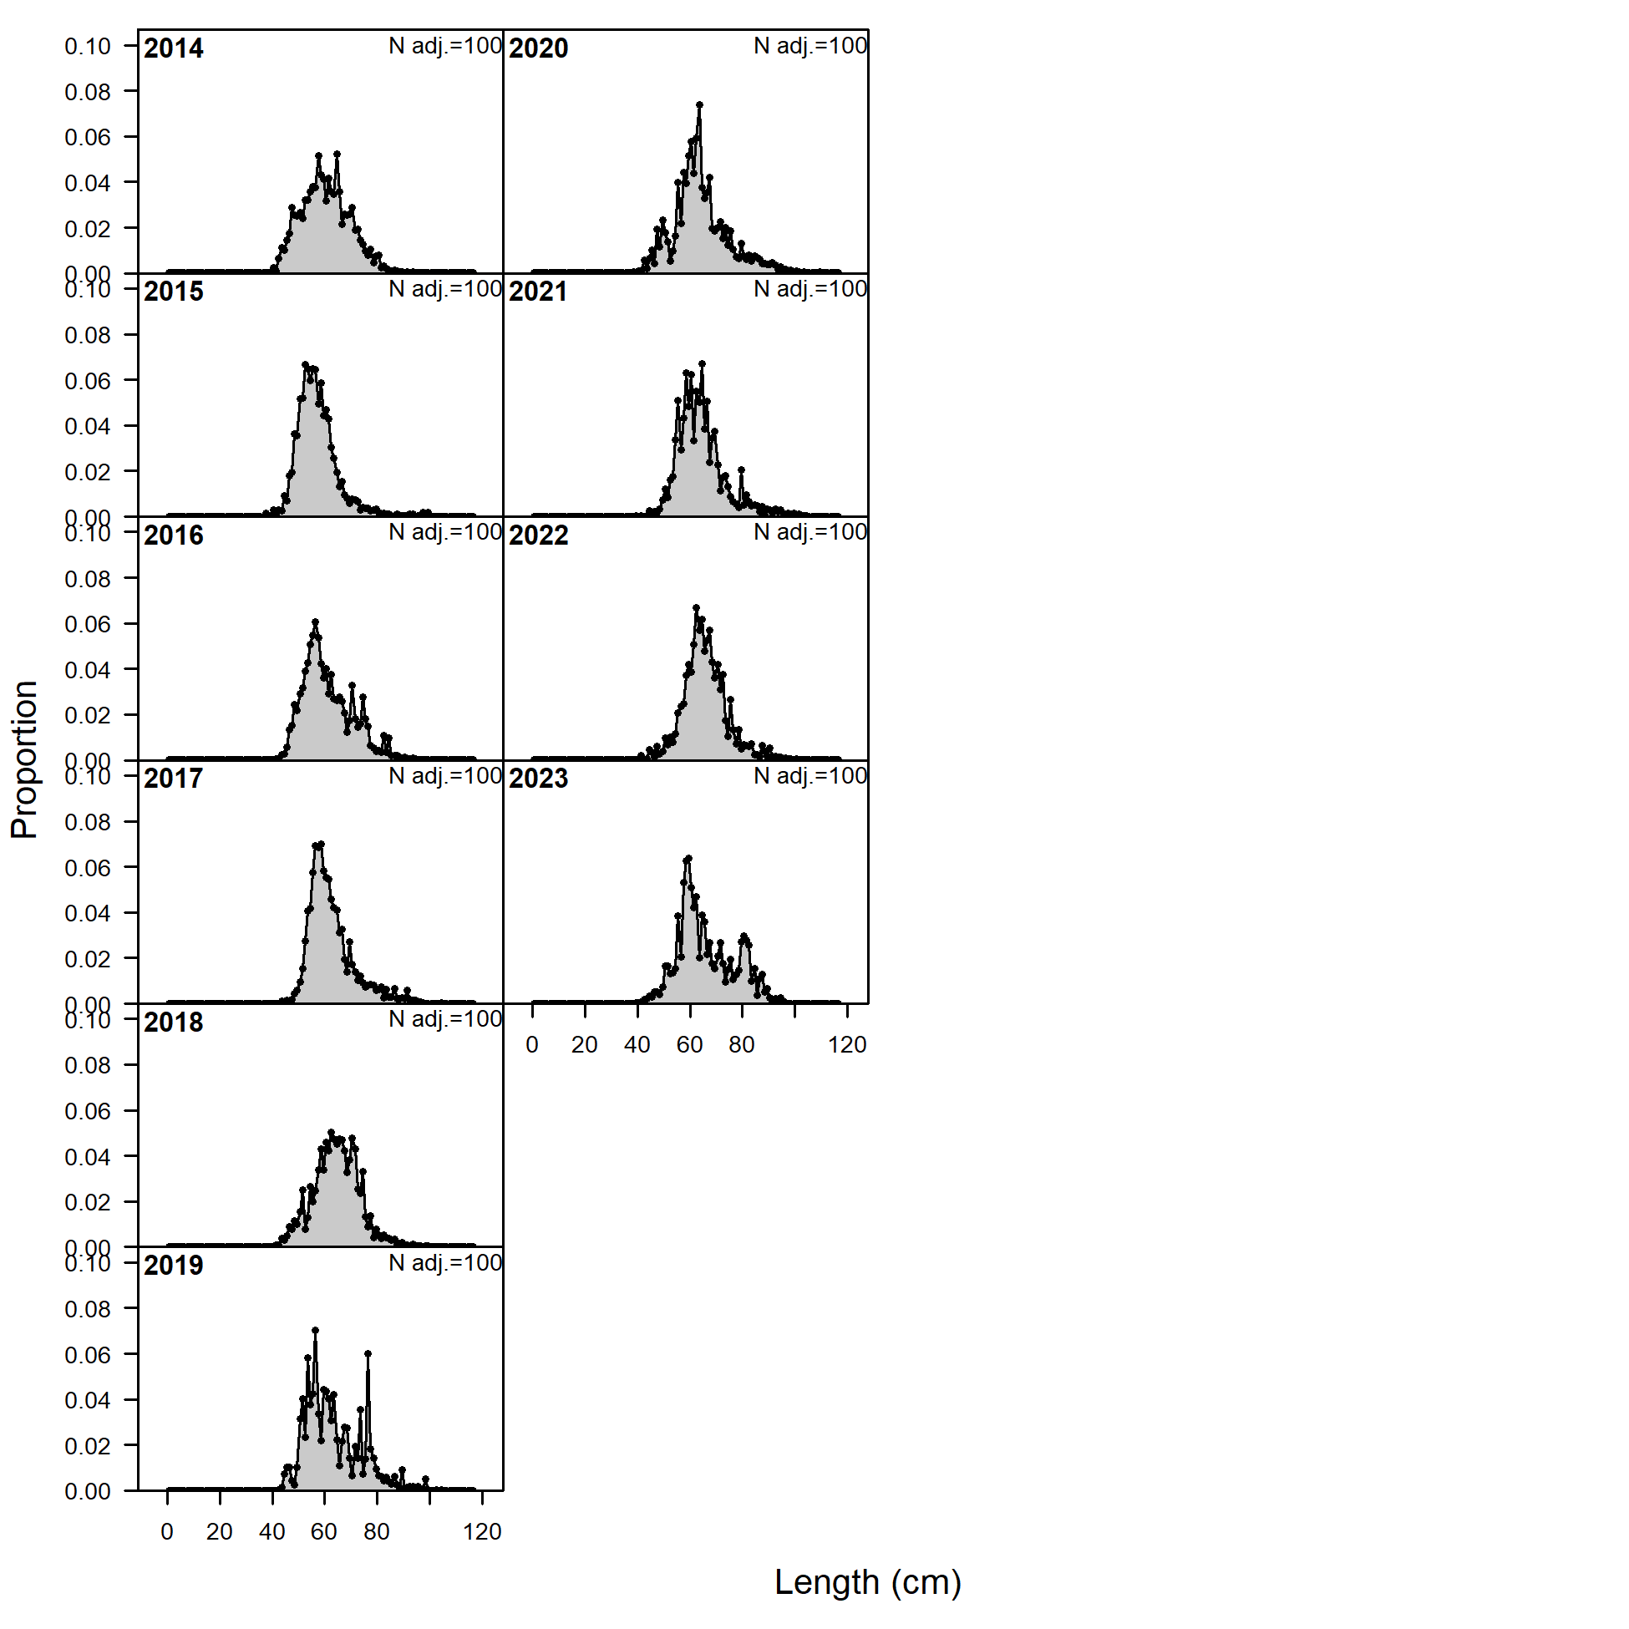
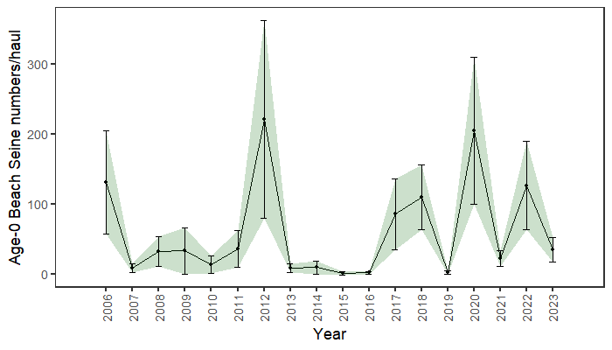
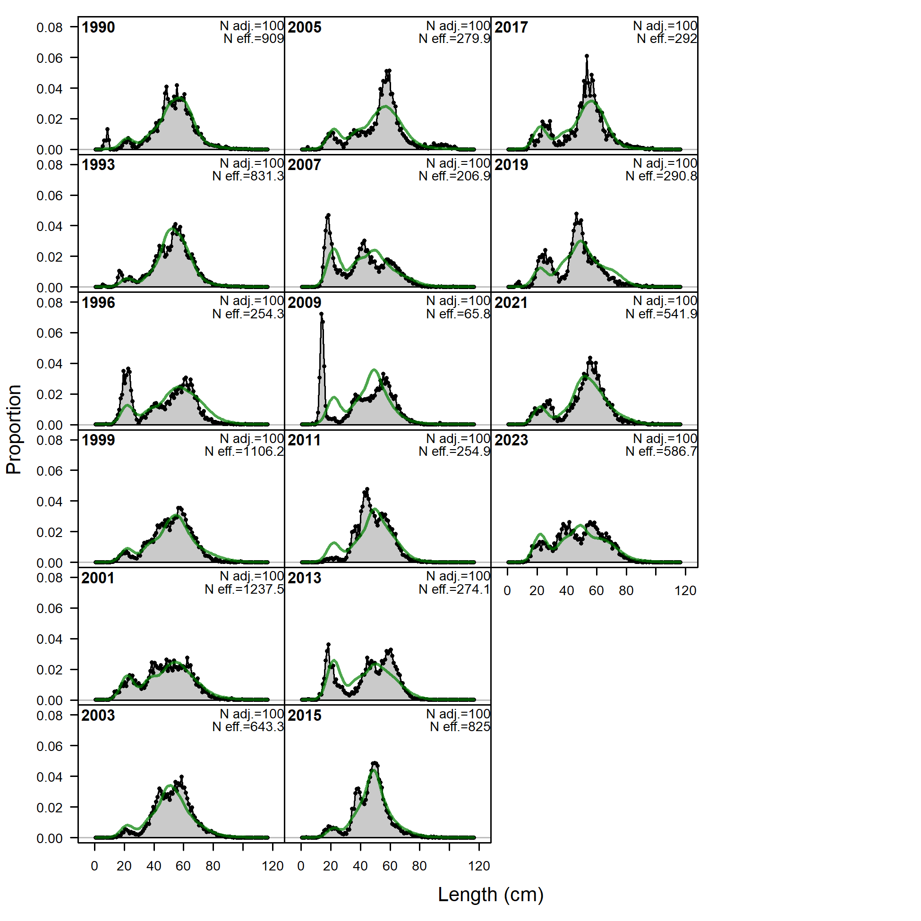
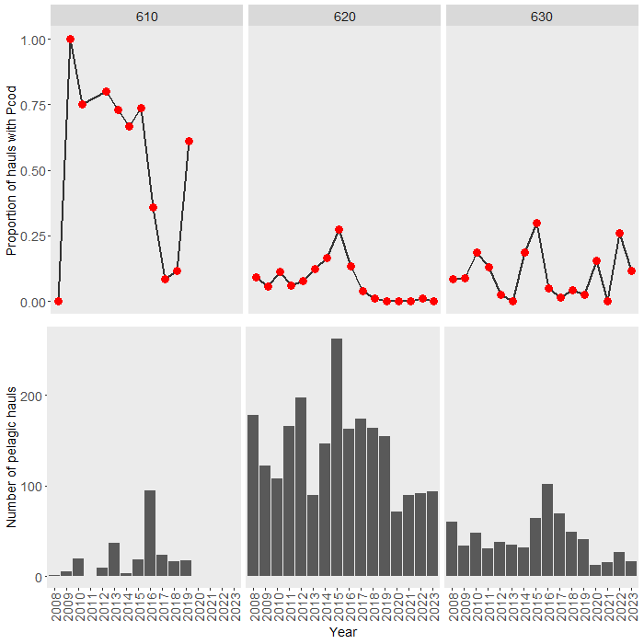
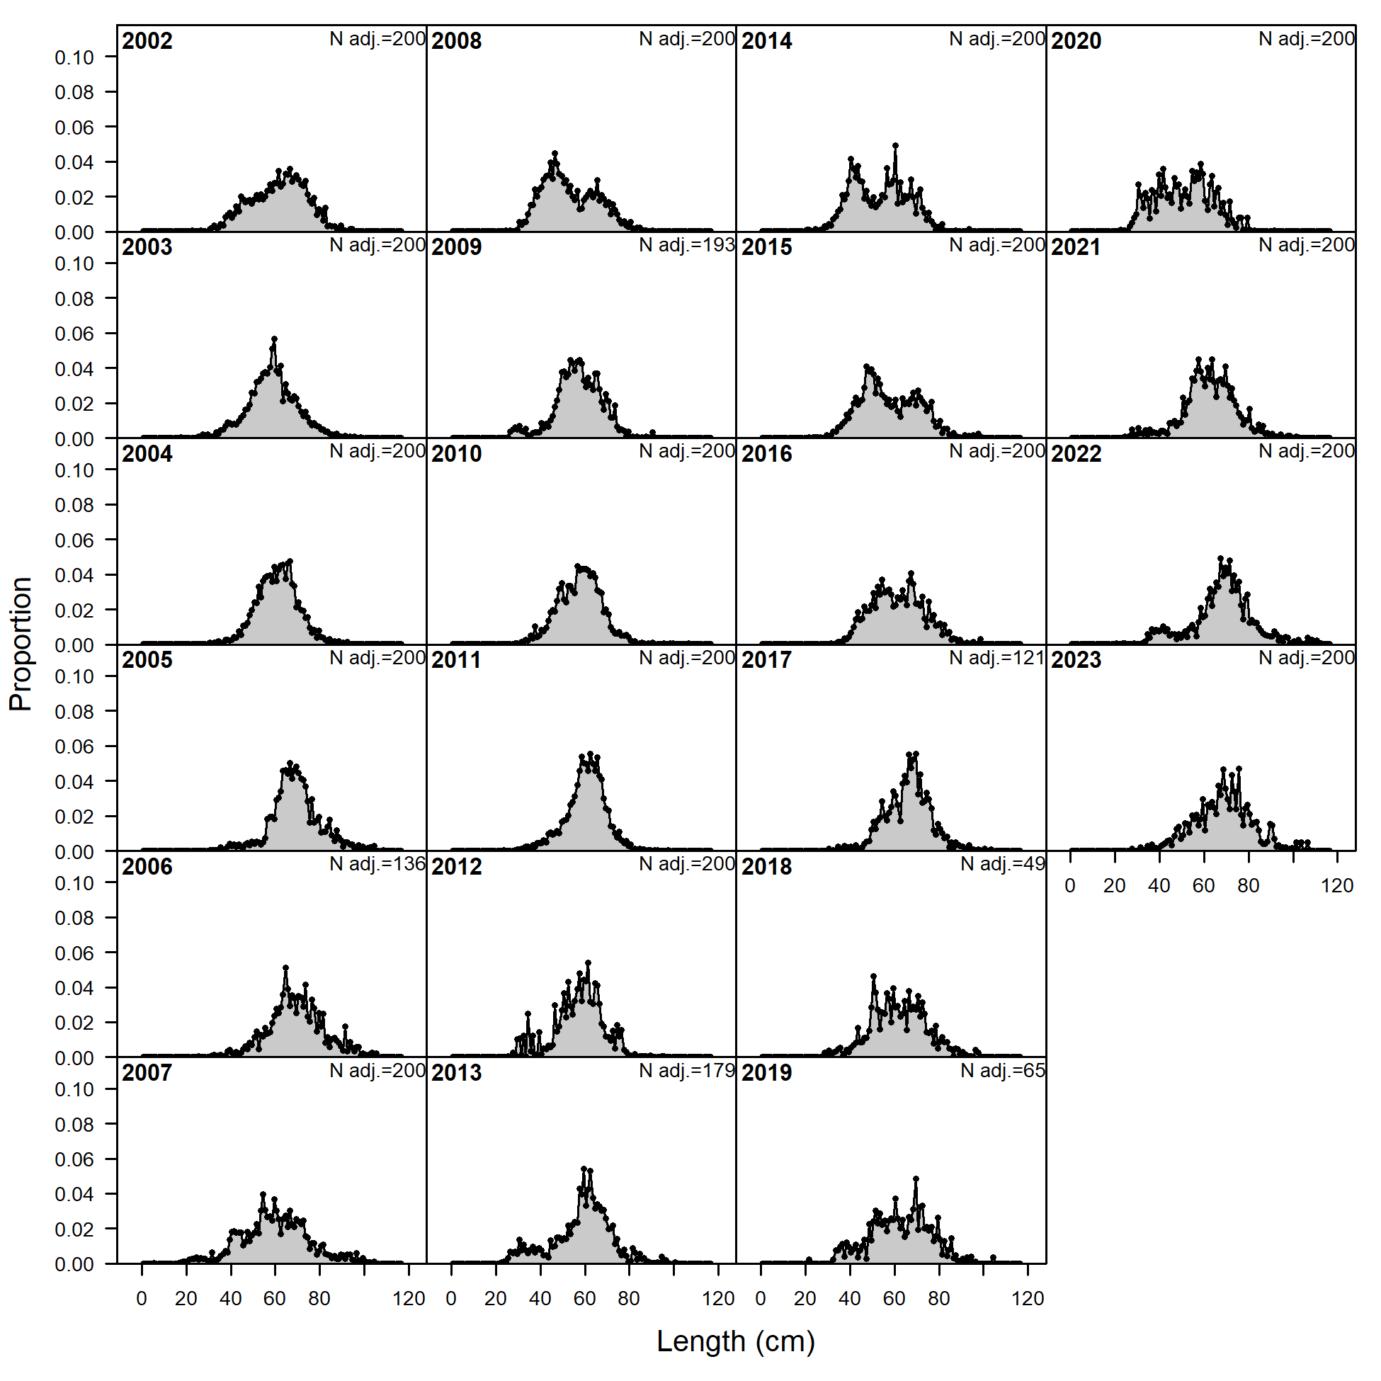
Risk table
Pop dy considerations: Recruitment
Is there any evidence of recent recruitment in data?
2017/18, 2020, and 2022 shows up in length comps, notably in trawl fishery
LL Survey
Trawl Survey
Trawl Fishery

Slide 15
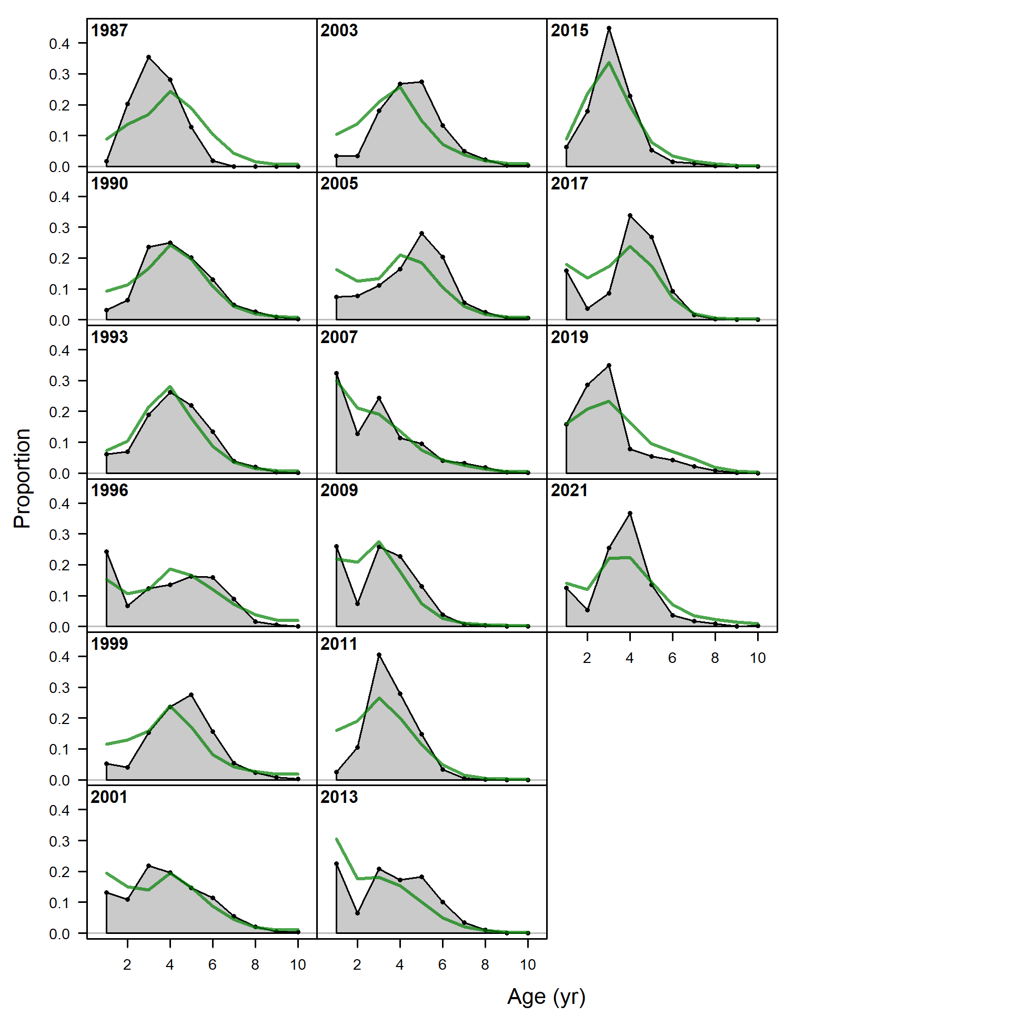
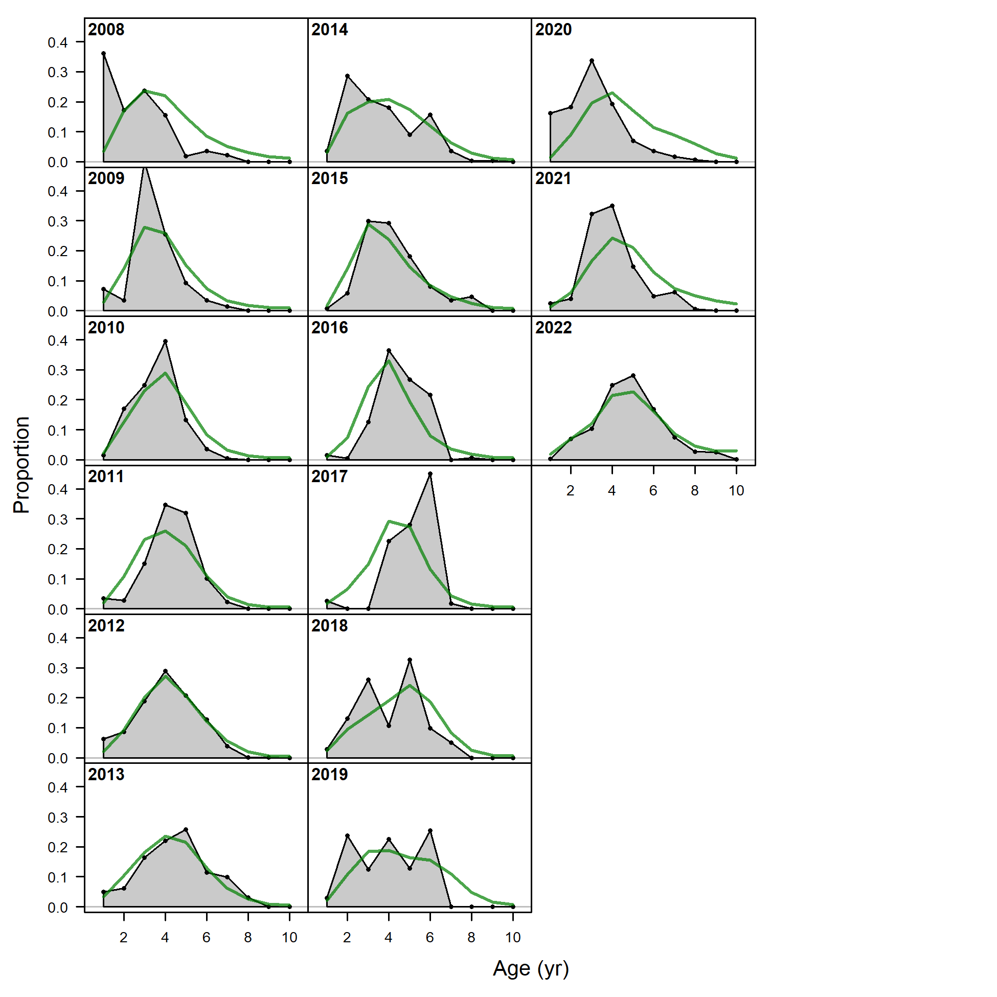
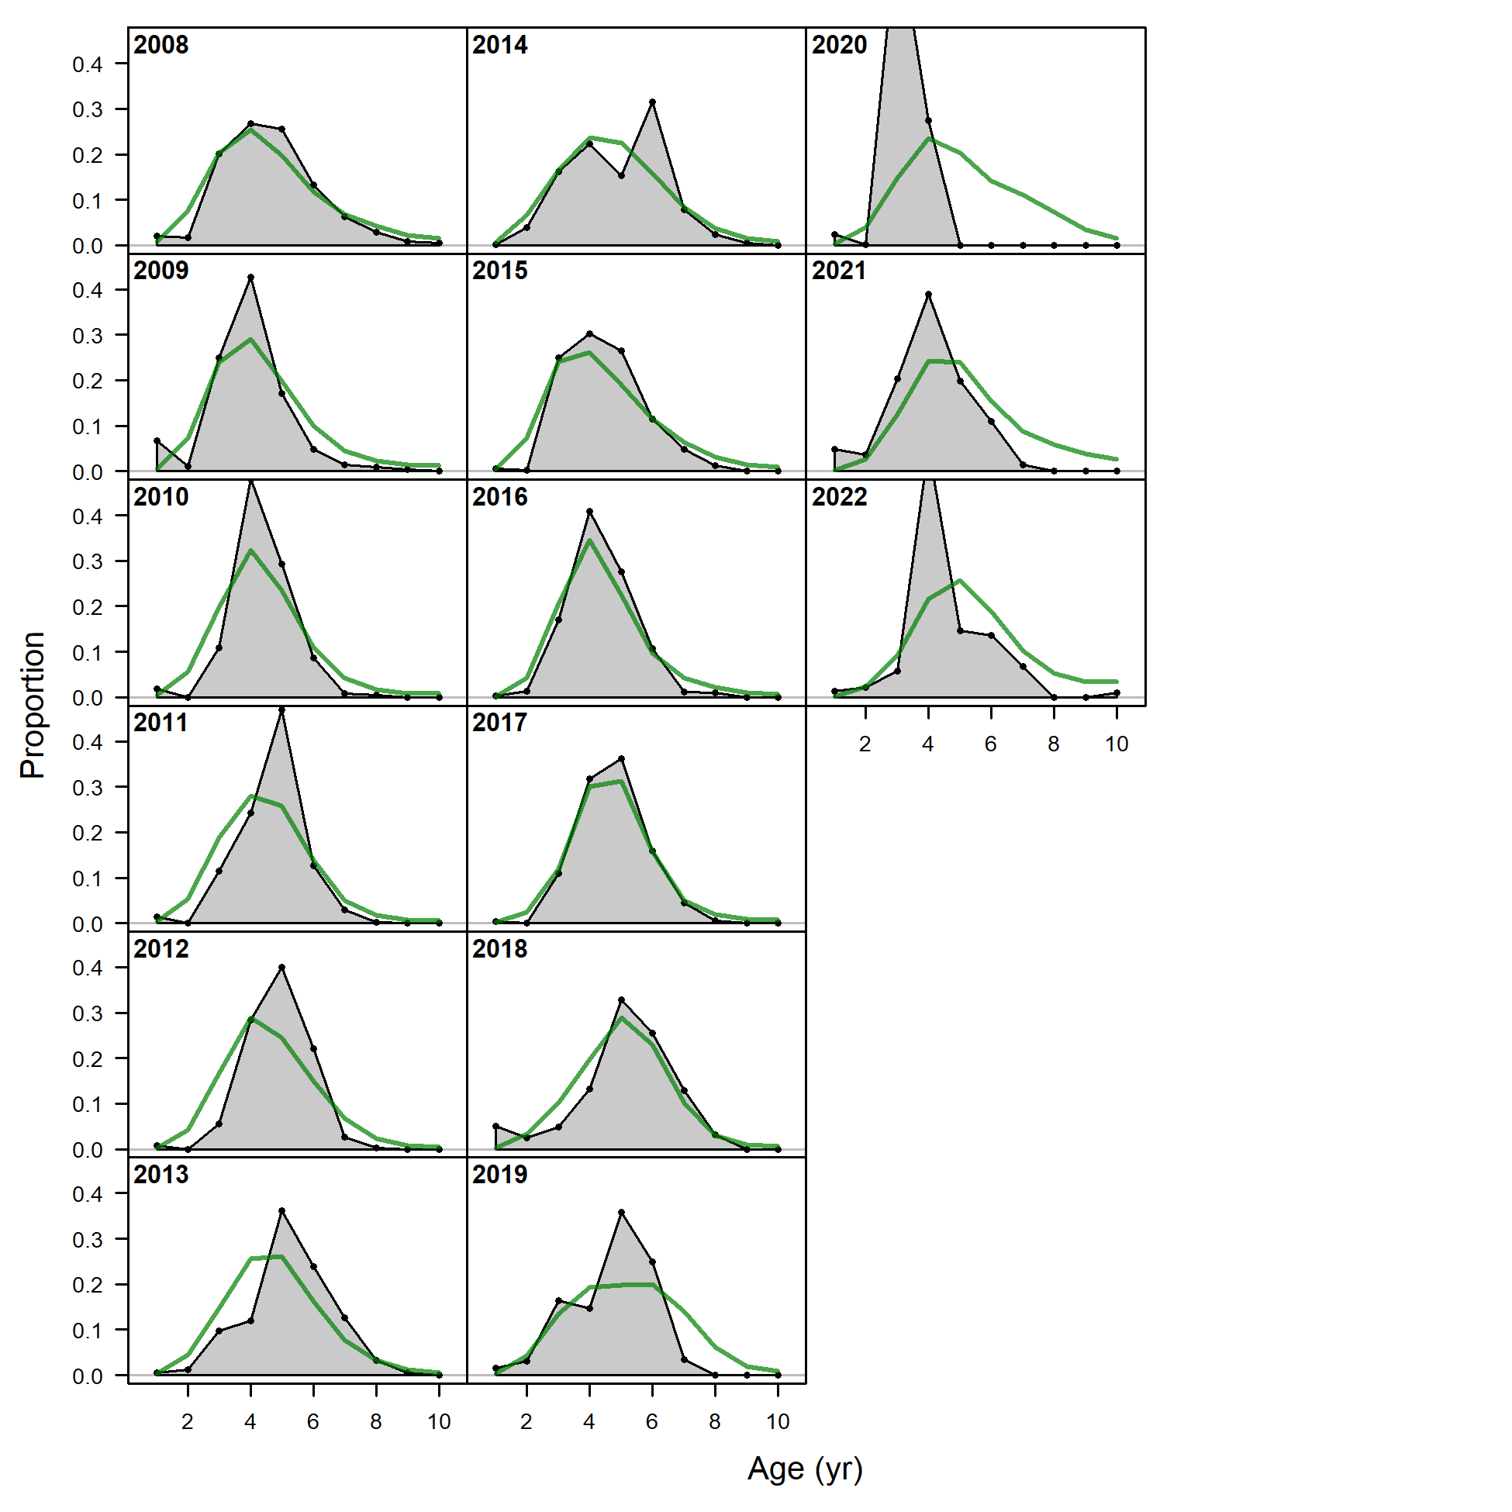
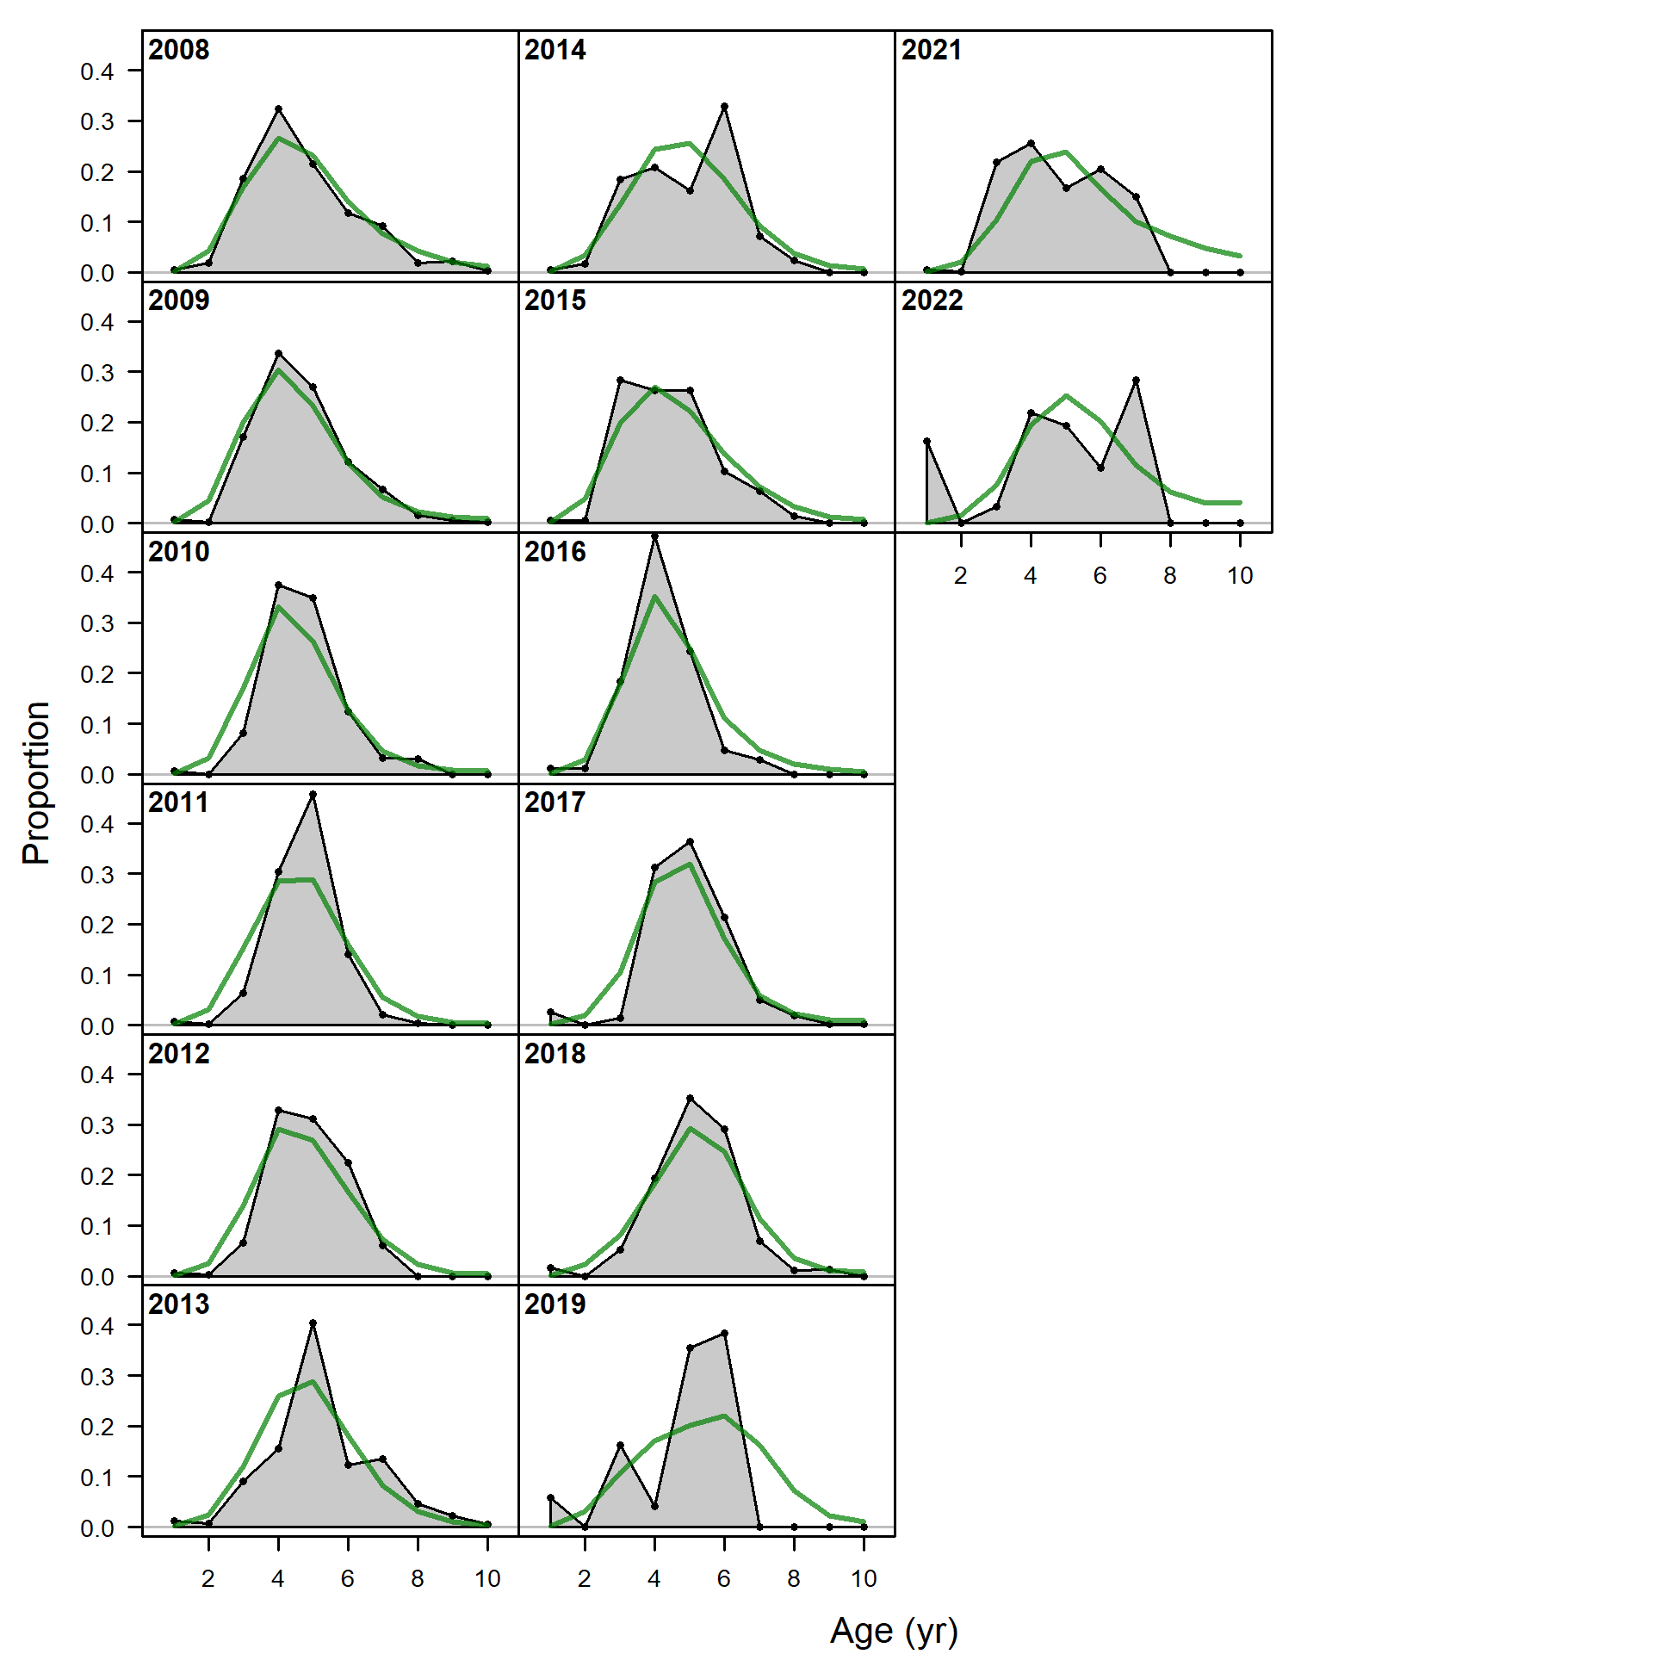
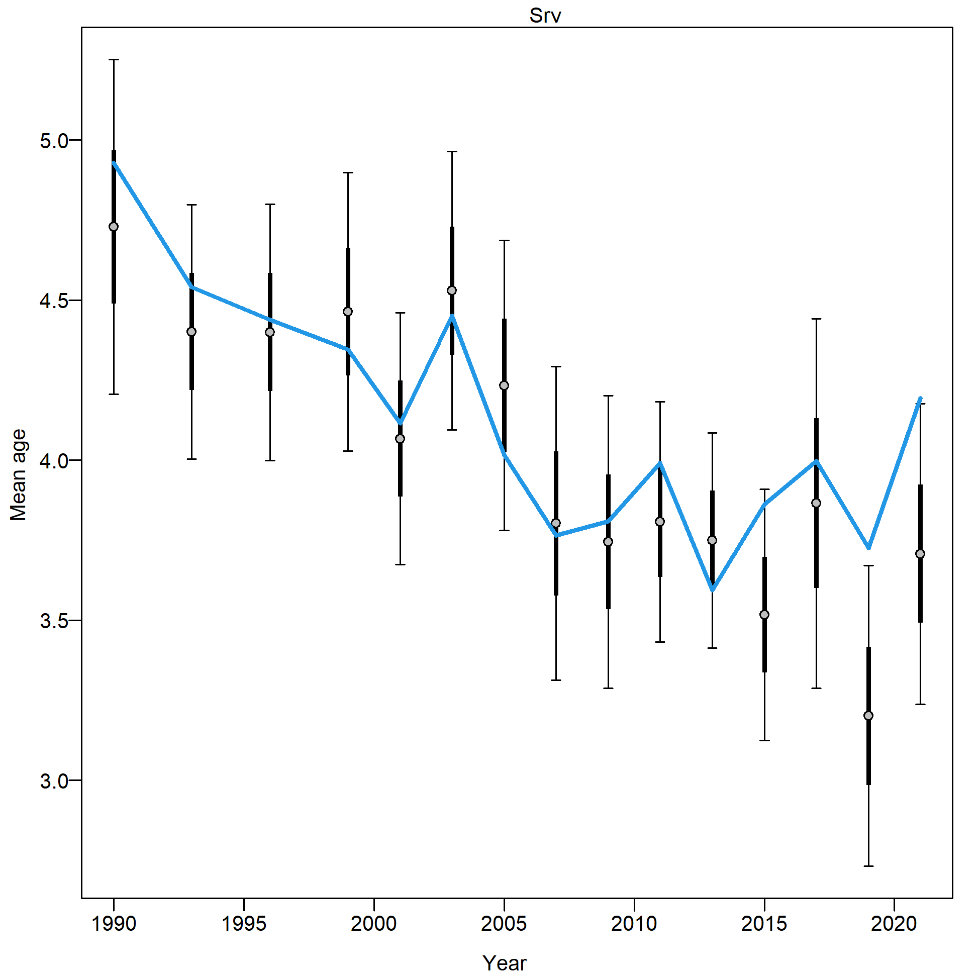
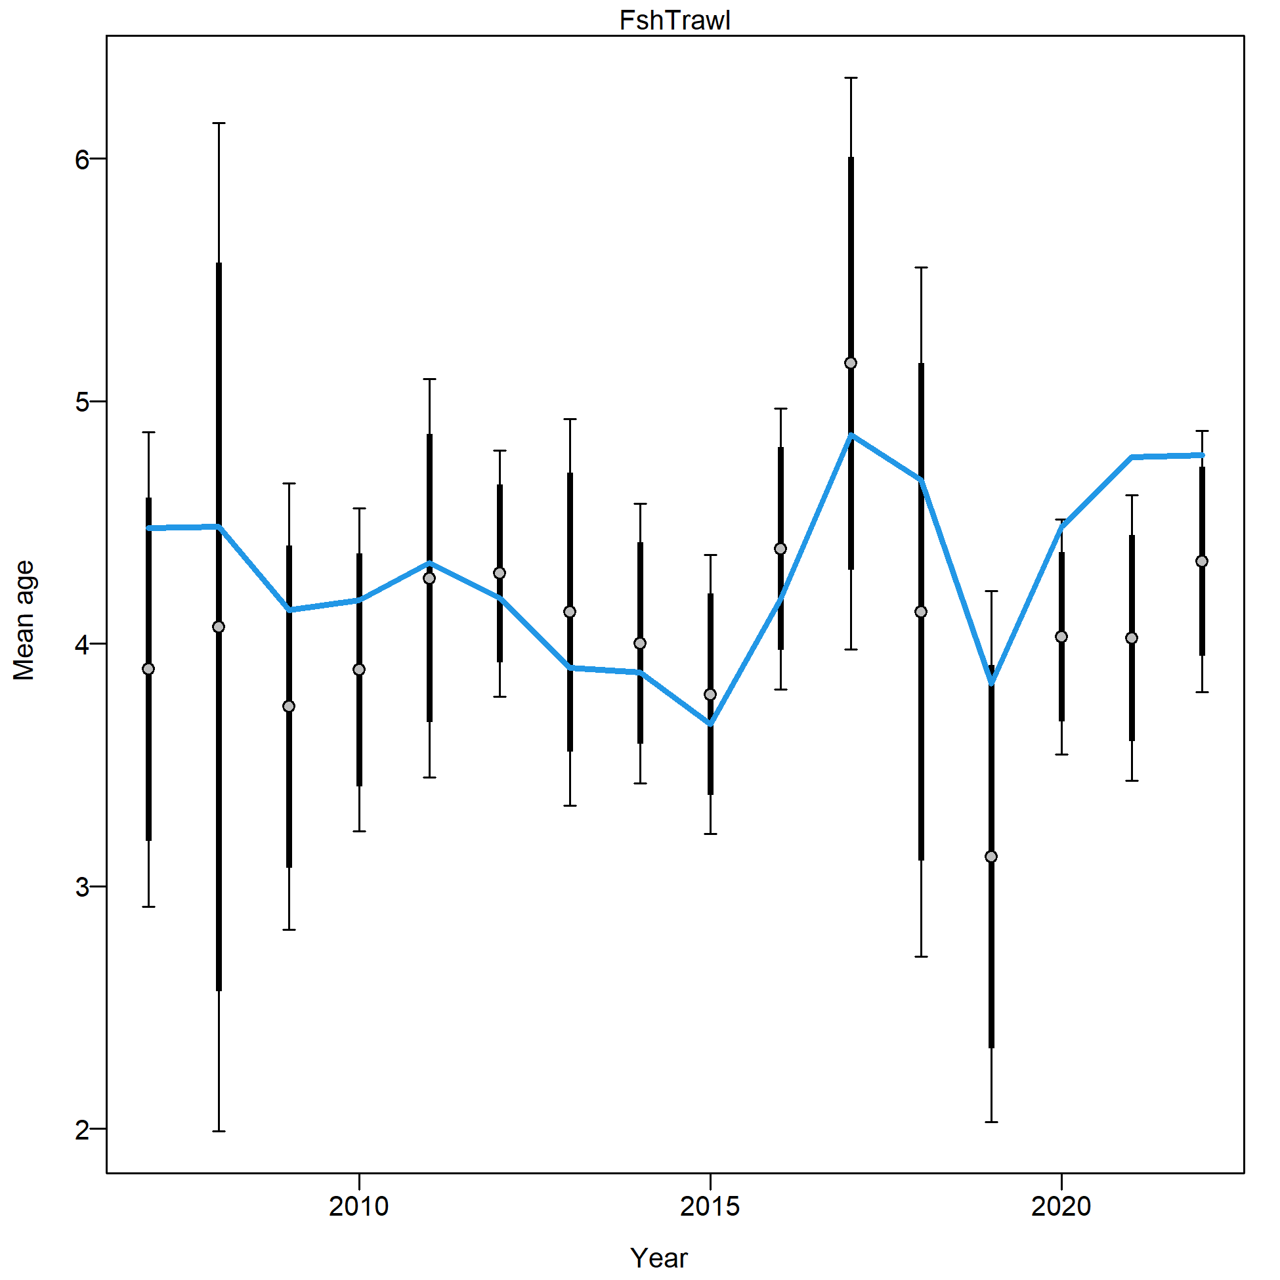
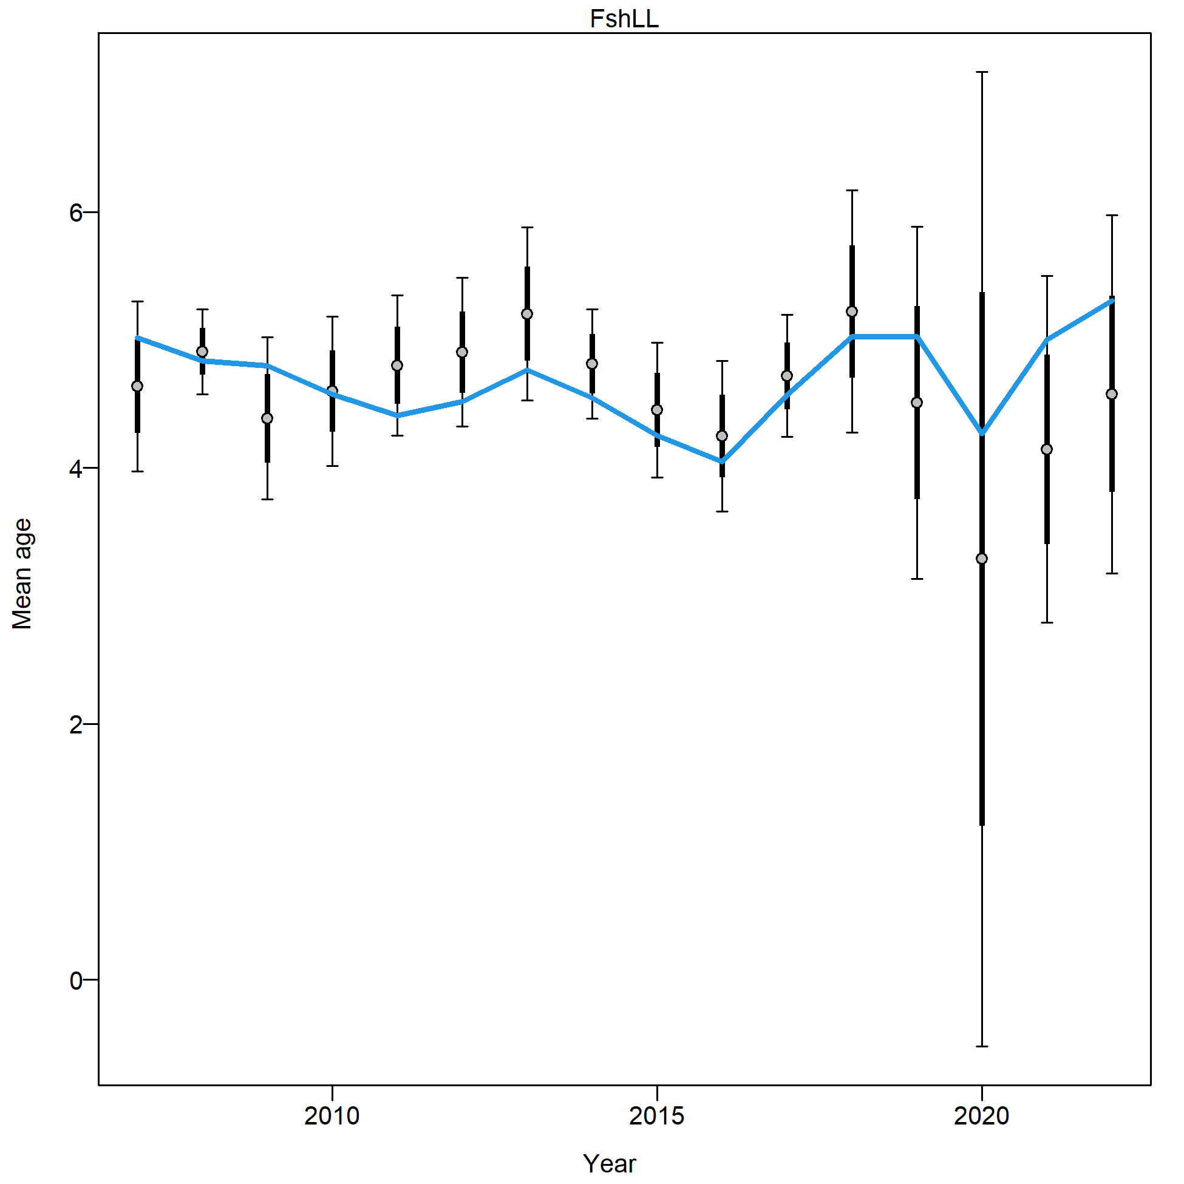
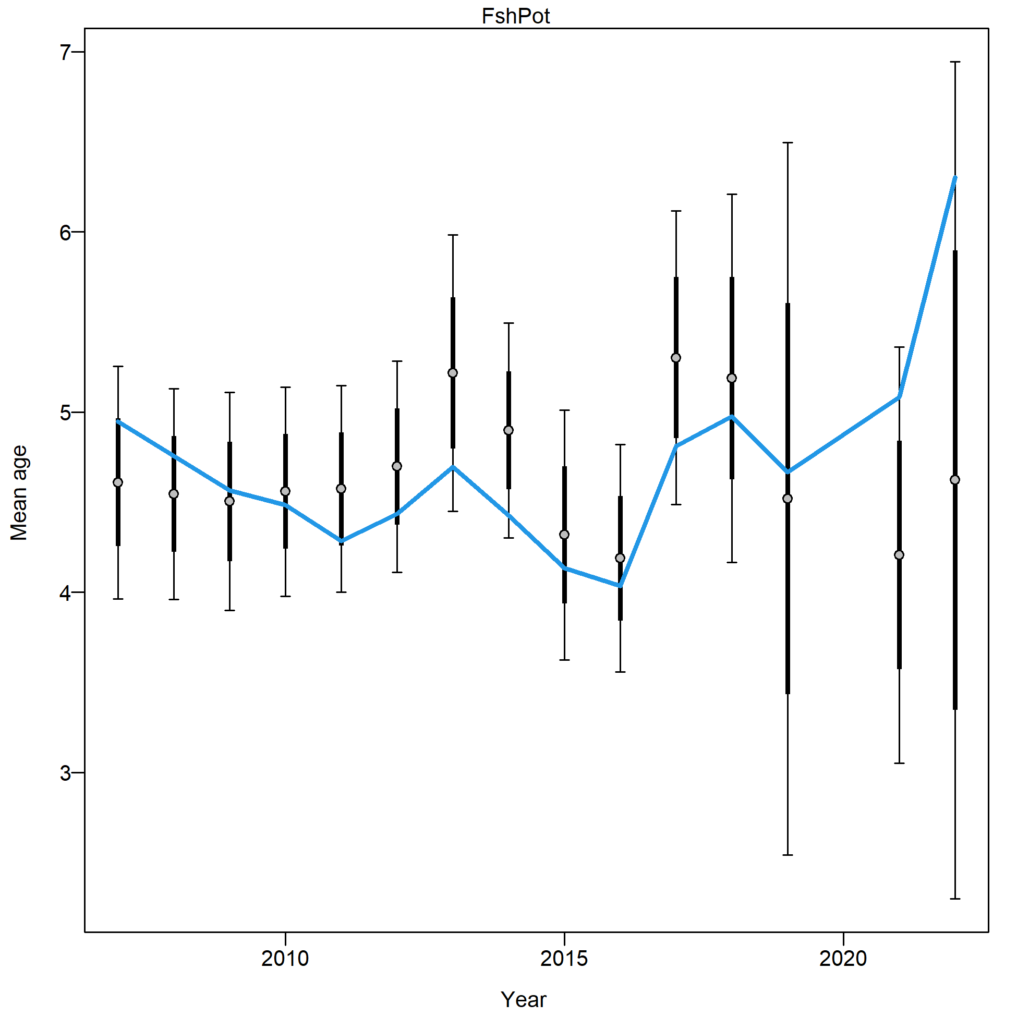
Risk table
Pop dy considerations: Recruitment
Is there any evidence of recent recruitment in data?
Consistent underestimation of recent age +3 abundance
Estimated mean age > observed mean age
Trawl Survey
Trawl Fishery
Longline
Pot

Slide 16
Risk table
Pop dy considerations: Recruitment
Is there any evidence of recent recruitment in data? Yes
Age-0 index and mid-water Pollock line up for at least the 2020 and 2022 year classes
These year classes are also seen in Trawl survey length comp data (with 2017/2018 as well), 2020 emerged in Trawl fishery
Is the model fitting it? No
Fit to recent year classes in Trawl length comp data fit poorly (mostly in sense that model expects less than what is in data)
Consistent underestimation of abundance of age 3-4 in age comp data for all data sources
Consistent overestimation of mean age (meaning, the model estimates less younger fish than observed)
Summary: considerable uncertainty in accuracy of model estimates of recent recruitment

Slide 17
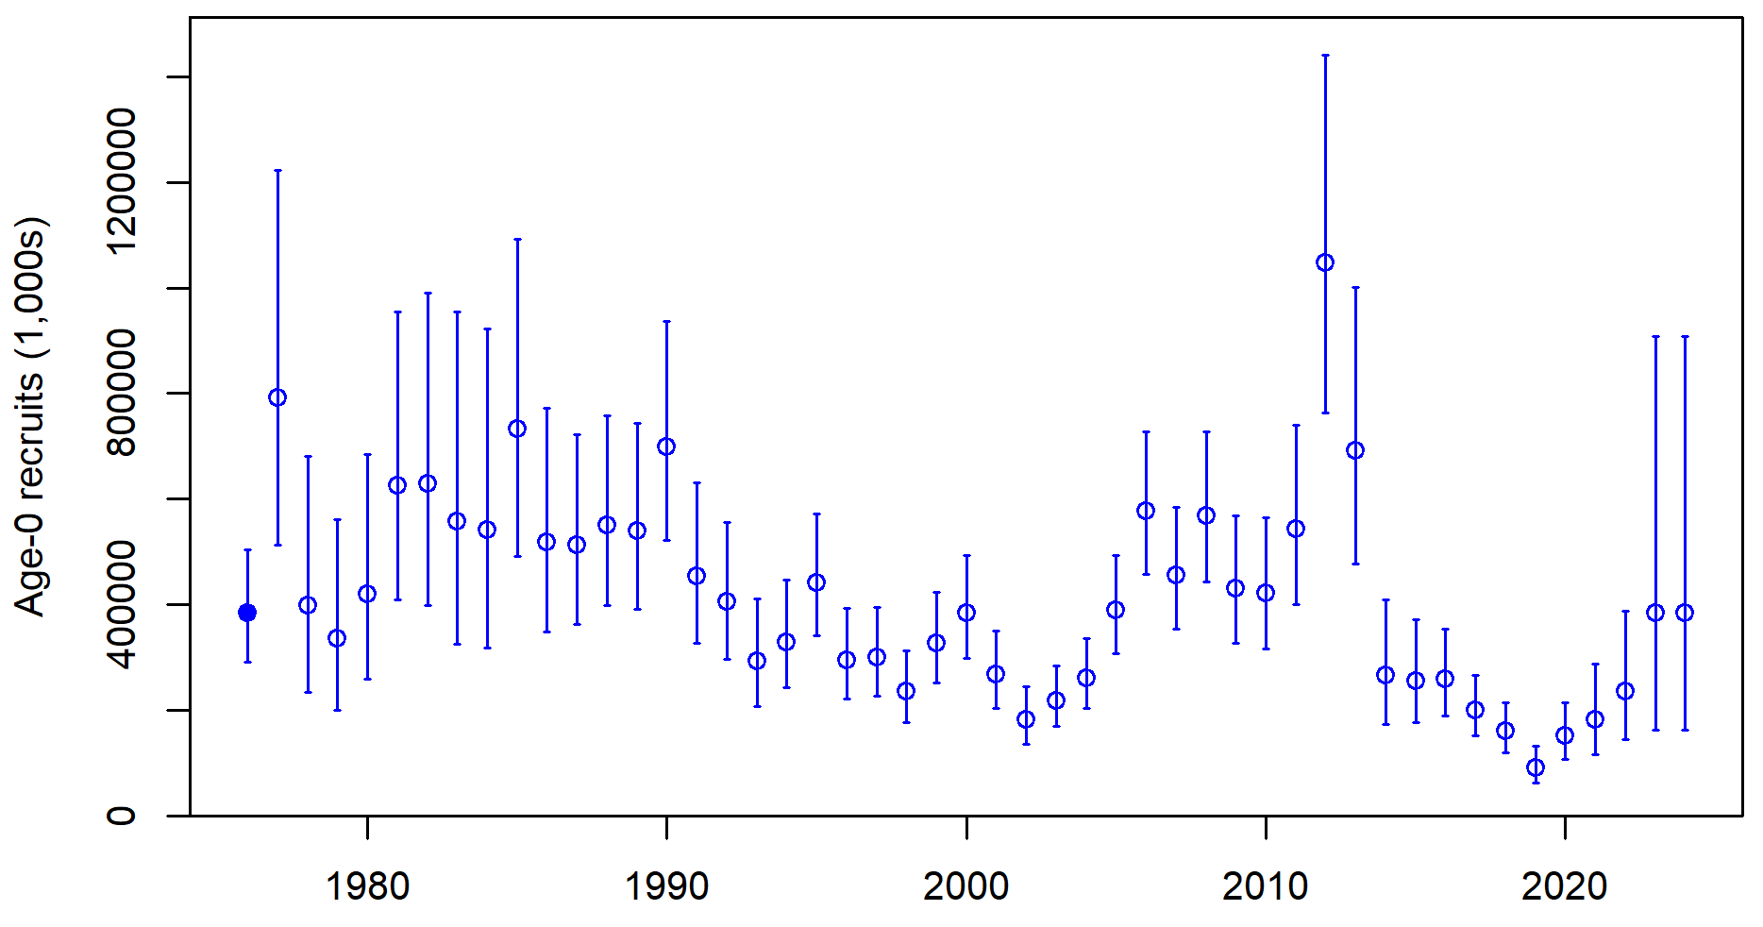
Risk table
Pop dy considerations: Recruitment
Have we been here before?
2019 draws eye to how low it is, but others similar in scale to what was seen in late 90s – early 00s

Slide 18
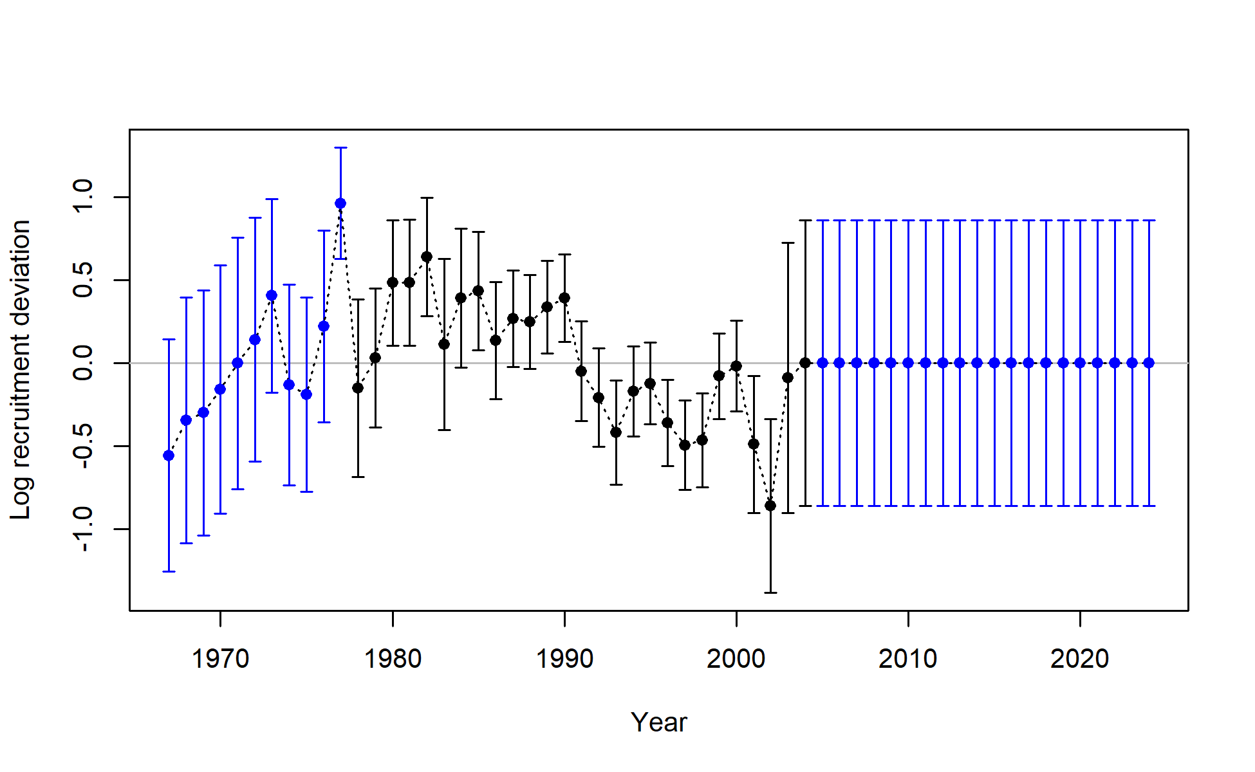
Risk table
Pop dy considerations: Recruitment
Have we been here before?
Data retrospective: 12 consecutive below avg recruitment with data through 2004
2004 assessment
2023 assessment

Slide 19
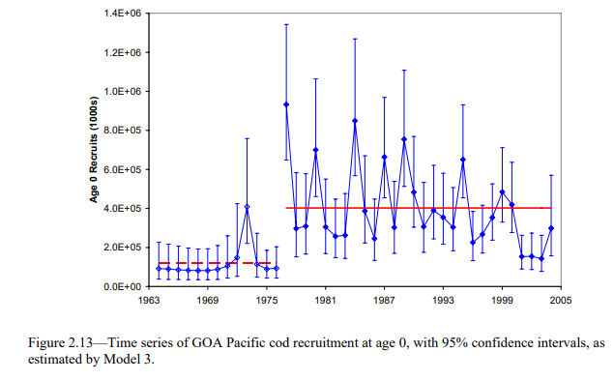
Risk table
Pop dy considerations: Recruitment
Have we been here before?
Model retrospective: 11 of 14 years with below avg recruitment in 2005 assessment
2023 assessment
2005 assessment
(Thompson and Dorn, 2005)

Slide 20
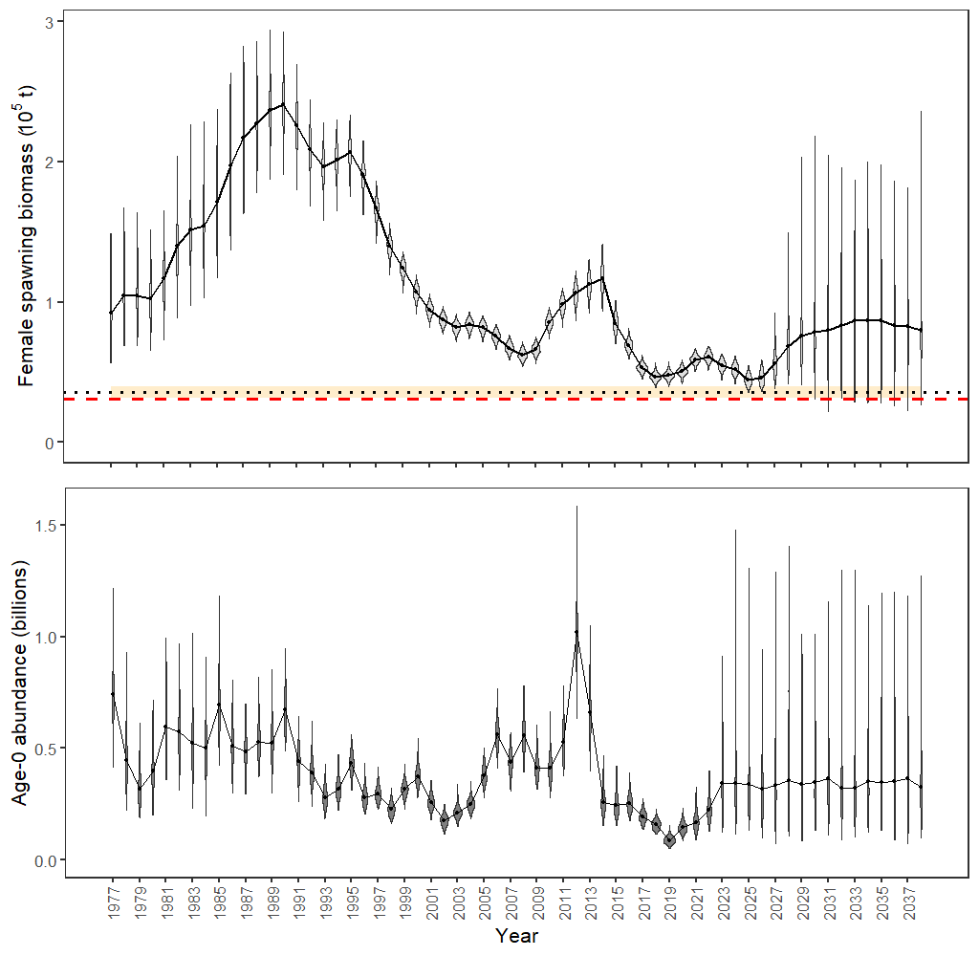
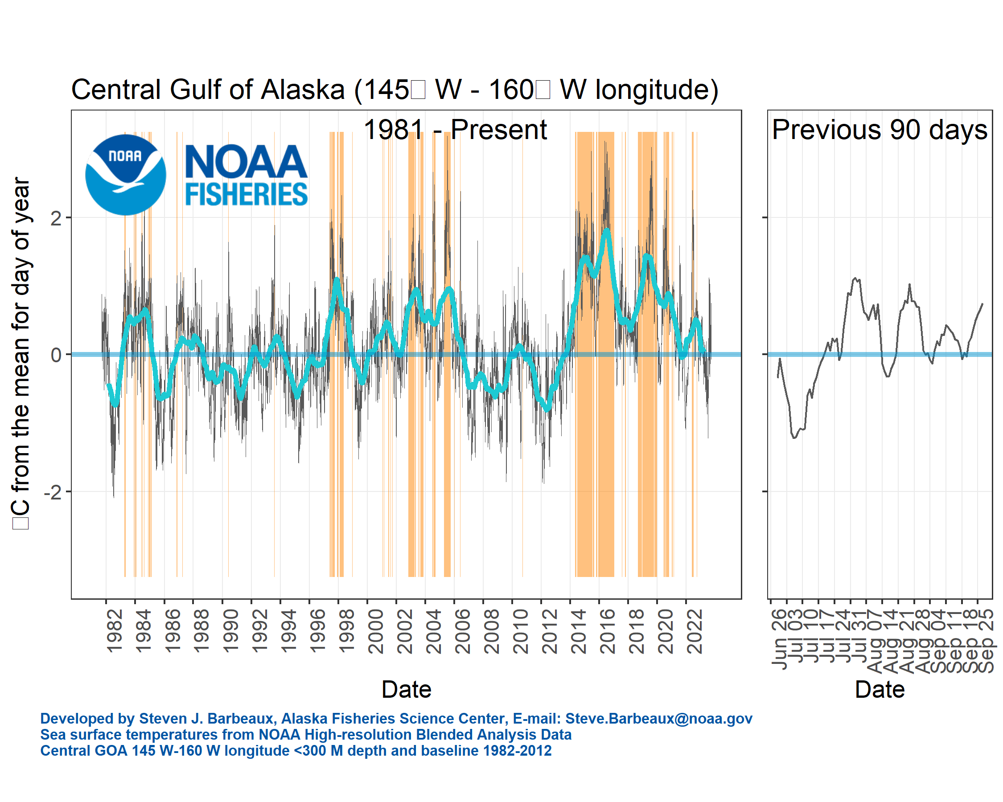
Risk table
Pop dy considerations: Recruitment
Have we been here before?
SSB
R
CGOA SST

Slide 21
Risk table
Pop dy considerations: Recruitment
Have we been here before? Yes
String of below avg recruitment 1990s to mid-2000s
What happened?
Favorable environmental conditions led to above average recruitment after mid-2000s and SSB subsequently increased
Recent environmental conditions more extreme than in recent history
Hard to say whether favorable environmental conditions could return
Summary: considerable uncertainty in projected environmental conditions, and relationship with recruitment and stock increase/decrease

Slide 22
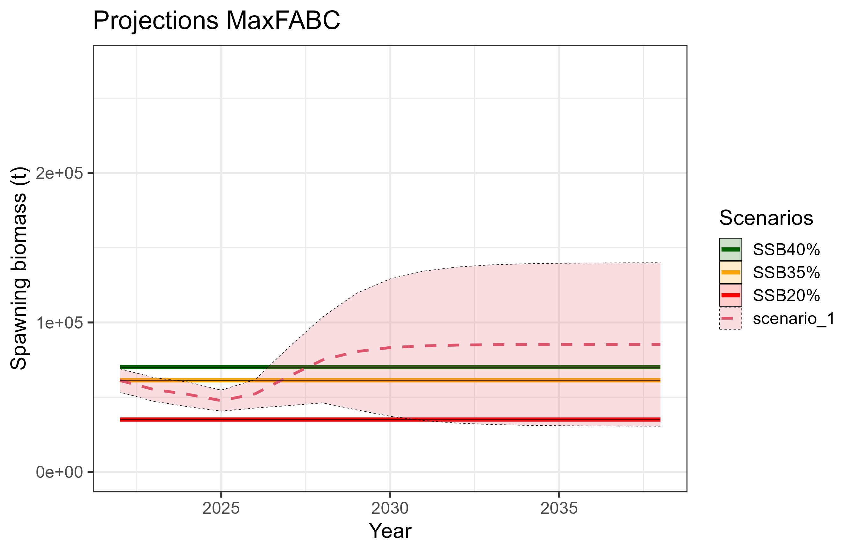
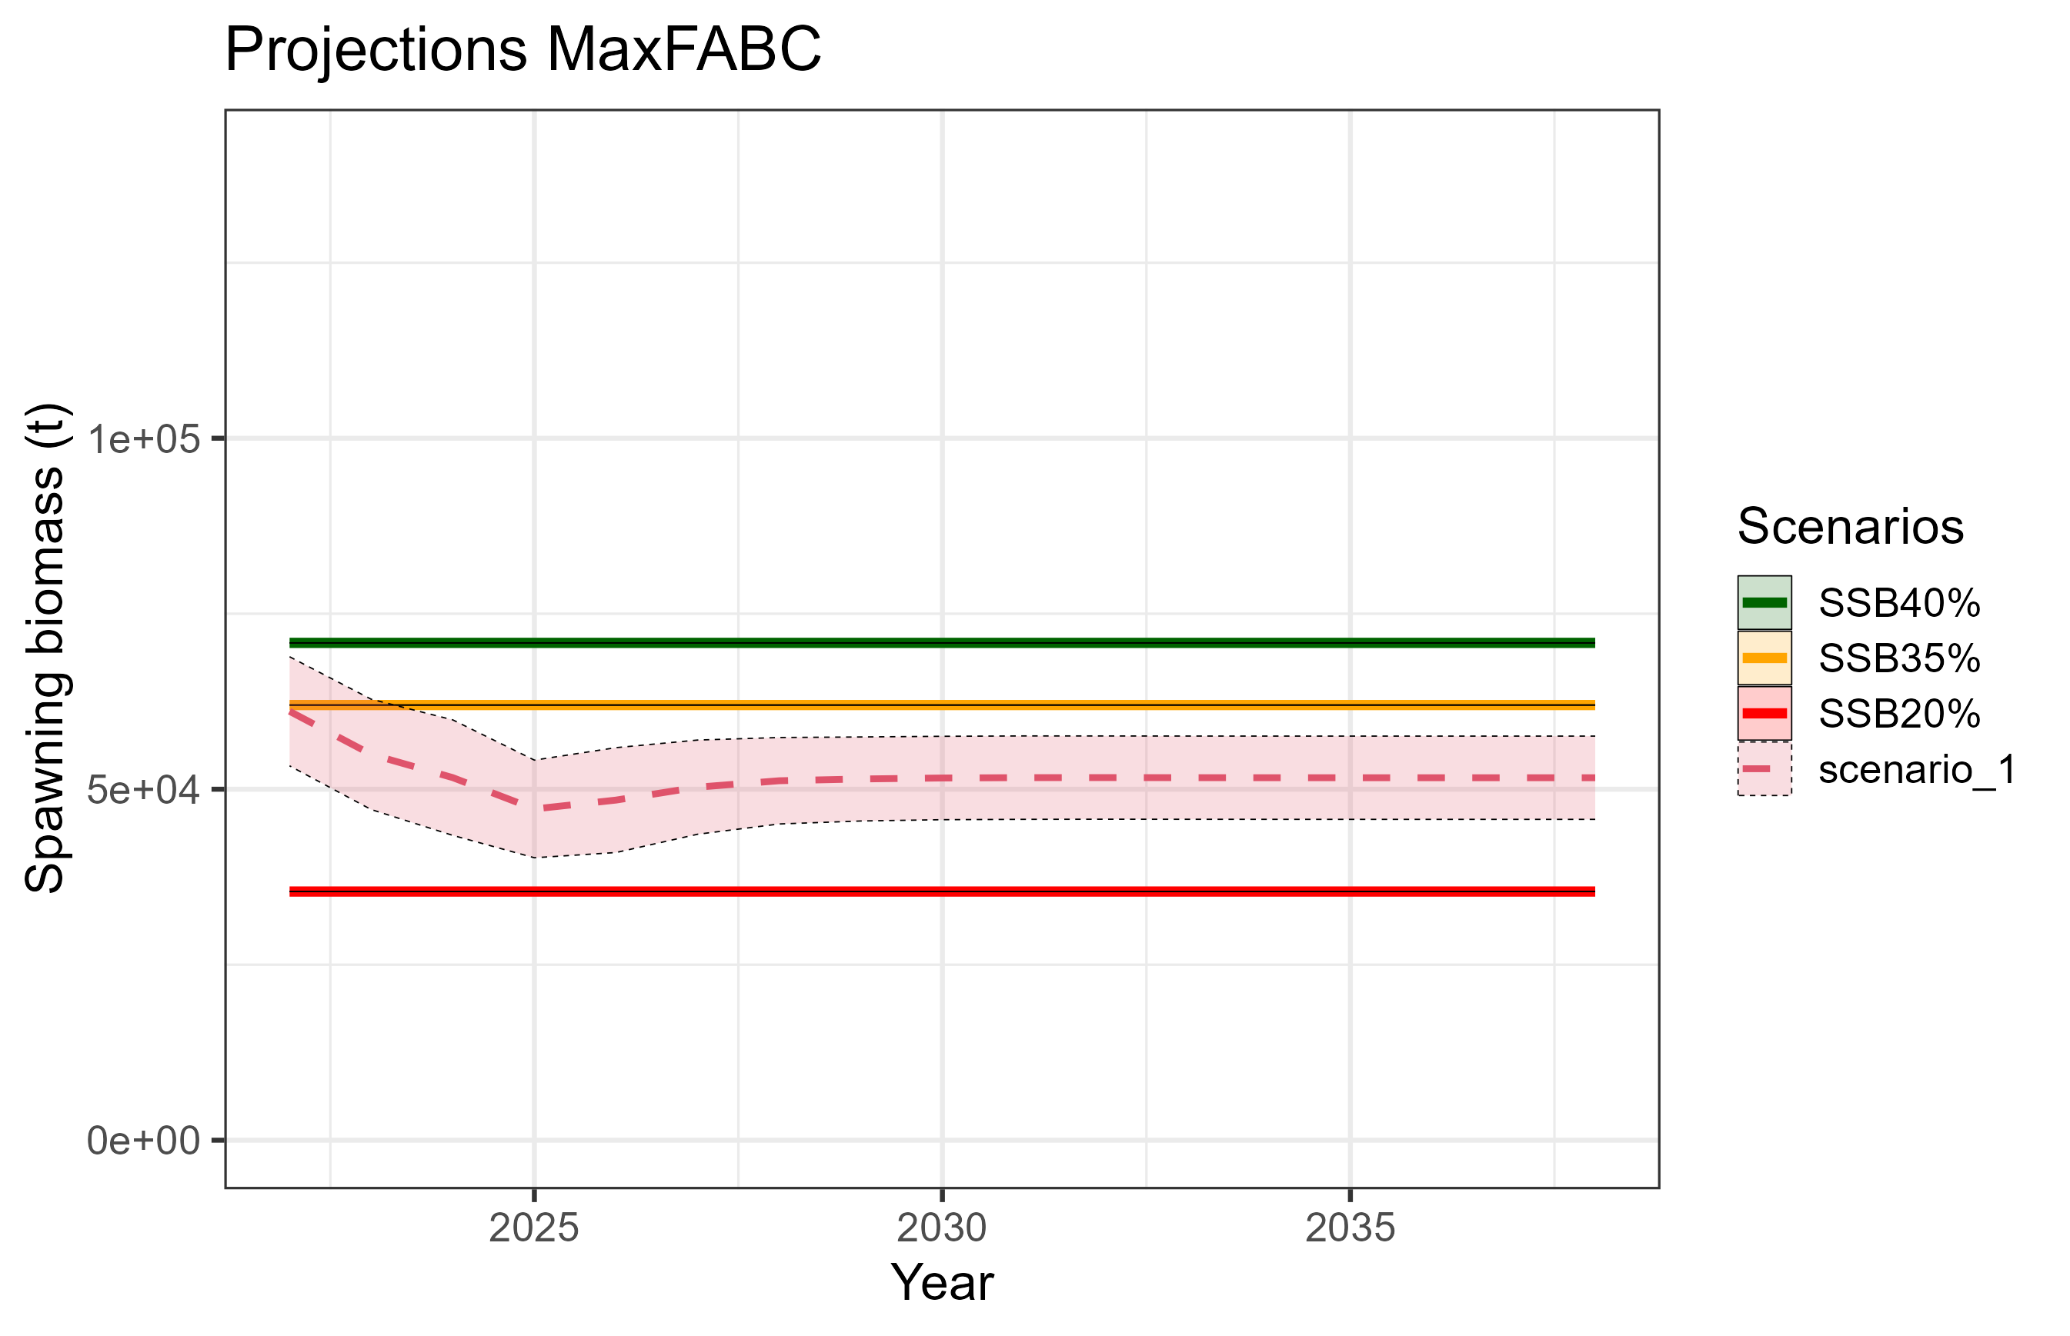
Risk table
Pop dy considerations: Recruitment
What are the consequences? SSB
Use mean recruitment from 2014 on in projections
Short term consequences: ~ 2% difference in 2024 ABC
Long term consequences: never get back to B_{35%}, hover around B_{29%}
1977 on
2014 on

Slide 23
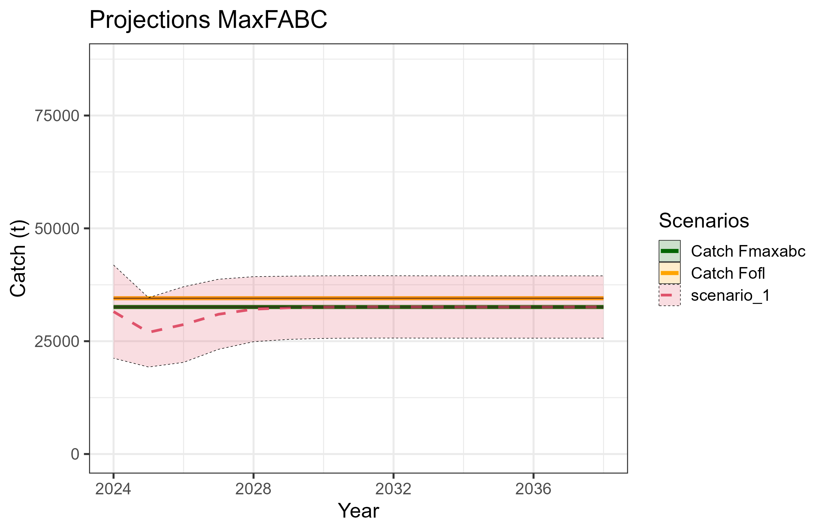
Risk table
Pop dy considerations: Recruitment
What are the consequences? ABC
With recent mean recruitment, projected ABC dips in short term, then hovers around 30,000 t

Slide 24
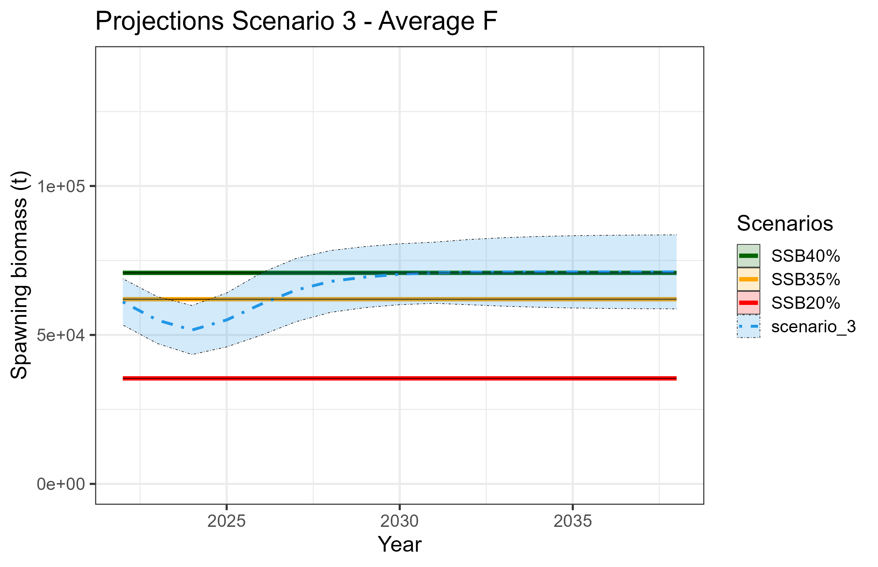

Risk table
Pop dy considerations: Recruitment
If recent mean recruitment here to stay, is there a way to rebuild?
2 scenarios rebuild to at or above B_{40%}

Slide 25


Risk table
Pop dy considerations: Recruitment
If recent mean recruitment here to stay, is there a way to rebuild?
2 scenarios rebuild to at or above B_{40%}
Avg F: 2024 ABC ~ 11,000 t, long term ~21,000 t
F75%: 2024 ABC ~ 8,000 t, long term ~ 16,500 t
But, is recent mean recruitment here to stay?

Slide 26
Risk table
Pop dy considerations:
Low levels of biomass persists – this continues to be a major concern, primarily because of how close to biomass reference limits we are
As estimated by the model, recruitment has been below average since 2014
We’ve learned population is sensitive to environmental conditions
Level 2: “Stock trends are highly unusual; very rapid changes in stock abundance, or highly atypical recruitment patterns.”
Level 3: “Stock trends are unprecedented; More rapid changes in stock abundance than have ever been seen previously, or a very long stretch of poor recruitment compared to previous patterns.”
Based on evidence available, rank at Level 2

Slide 27
ABC/OFL recommendations
Do we reduce from maxABC?
Low levels of biomass will remain a concern until (if) pop’n rebuilds
Recent recruitment estimates concerning, but, there’s evidence model isn’t fitting recent year classes well, and, in terms of magnitude of recruitment, we’ve been here before
Information provided as to consequences of low recent recruitment becoming the norm, and associated catches to rebuild, but, there is substantial uncertainty associated with long term projections
What is risk to stock of doing major damage based on the 2024 ABC recommendation?
If we have a major environmental event in the next year or two, is reducing ABC this year going to mitigate the pop’n decline? Would reduction in catches around 2015 have mitigated pop’n crash?
Will pop’n decrease next year? Possibly, but the model will track any decrease or increase
Keep in mind: stock in Tier 3b, reduction in ABC has already occurred

Slide 28
ABC/OFL recommendations
Do we reduce from maxABC?
Historical context:
Short-term (with Model 2019.1 series):
2021 → 2022 ↑39%, 2022 → 2023 ↓25%, recommended 2023 → 2024 ↑31%
Used to determine stock <B_{20%} in 2020
Long-term (with what we estimate from model now):
Avg SSB from 2018-2023 24% smaller than 2006-2010,
Avg ABC from 2018-2023 (taking out 2020) 64% smaller than 2006-2010
Recommendation: no reduction from maxABC

Slide 29


apportionment
↑17%
↑39%
↑26%

Slide 30

Questions?

Slide 31

Data – catch comps
1st pass evaluating observed effort of Pot fleet: distribution of length samples

Slide 32
Data – catch comps
2nd pass evaluating observed effort by gear type (Trawl, Longline, Pot):
Relative proportion of catch by gear type: gear specific catch divided by total annual catch
Relative proportion of observed catch by gear type:
Step 1: for each gear type, divide observed catch (extrapolated weight summed across hauls, converted to mt) by total catch
Step 2: with proportions from Step 1, compute relative proportions across gear types
Simple example: 10% of total catch observed for gear type 1, 5% of total catch observed for gear type 2 => 66% of relative proportion of observed catch is for gear type 1, 33% for gear type 2. If the observed catch rates were the same (i.e., 50/50), then the catch is observed proportional to the overall relative catch by gear type – so what we’re looking for is an even split among gear types
Relative proportion of observed catch sampled for length frequency by gear type:
Same procedure as for observed catch, but use observed catch from hauls that have length frequency sampling

Slide 33

Data – catch comps
Pot fleet underrepresented in both observed catch and length frequency

